Slide 1
Biodegradation of btex
Sean McCarthy
CE 421
11/29/2007

Slide 2
Introduction
Benzene, Toluene, Ethylbenzene, and Xylene are known as BTEX
BTEX is a volatile organic compound found in petroleum products
The individual compounds that make up BTEX have other industrial uses
Solvents, fuel additives, and in the production of plastics
There are many sites across the United States that have been contaminated with BTEX
The majority of sites are underground storage tanks (UST)

Slide 3
Health Concerns
Exposure can result from ingestion, inhalation and adsorption
Known long term health effects from BTEX include
respiratory disease, kidney, liver and blood problems
Sensory irritation and central nervous system depression
Benzene is a known human carcinogen

Slide 4
Health Concerns
The majority of people showing signs of illness caused by BTEX were exposed in an occupational setting
Occupational workers had higher incidences of leukemia
The maximum contaminant levels are
Benzene 5 ppb
Toluene 1000 ppb
Ethylbenzene 700 ppb
Xylene 10 ppm

Slide 5
Methods of Bioremediation
In-situ vs ex-situ
Aerobic vs anaerobic
Chemical oxidation
Adsorption

Slide 6
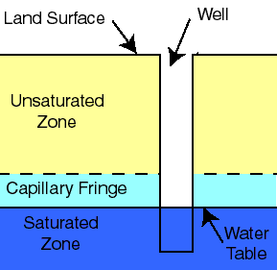
Zones of Remediation
Unsaturated zone
Soil from surface to edge of capillary fringe
Capillary fringe
Area above the water table where water fills the voids because of surface tension
Saturated zone
The area below water table

Slide 7
Enhanced Aerobic Bioremediation
Process of improving microorganism growth and efficiency in the presence of oxygen
Aerobic microorganism need oxygen, energy, nutrients and terminal electron acceptors
In most environments oxygen is the limiting factor
There are numerous methods of increasing oxygen in contaminated environments
Bioventing, biosparging, permeable barrier systems

Slide 8
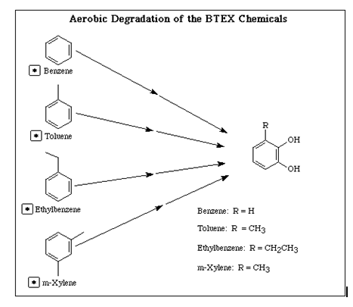
Aerobic Degradation Pathway

Slide 9
Enhanced Aerobic Bioremediation
Bioventing targets contaminates in the unsaturated zone
The goal is to add enough oxygen to promote sufficient biodegrading organism growth
Bioventing is an inexpensive way to increase oxygen concentrations
Bioventing can be limited by soil conditions
Low permeable soils are not suitable for bioventing

Slide 10
Enhanced Aerobic Bioremediation
Biosparging targets contaminates in the saturated zone
Like bioventing, biosparging involves increase oxygen levels
If there are insufficient nutrients in the soil for microorganism growth nutrients can be added
Also adding micro organisms that are known to be able to metabolize BTEX can improve results

Slide 11
Enhanced Aerobic Bioremediation
Permeable barrier systems are a series of wells drilled perpendicular to the flow of ground water
They are placed close enough together so that all ground water will be effected by the wells
MgO_{2,} CaO₂ can be used as oxygen suppliers
As water flows past the wells oxygen dissolves into the water
Maintenance problems can occur due to wells becoming clogged
This technology is still relatively new
More research and improvements need to be done

Slide 12
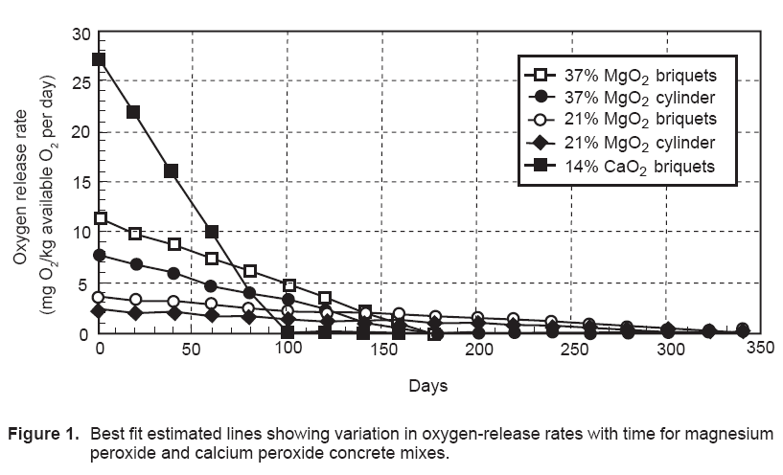
Permeable Barrier

Slide 13
Enhanced Anaerobic Bioremediation
Anaerobic conditions are usually formed when a ground water supply consumes all of its oxygen
In the absence of oxygen anaerobic bacteria degrade BTEX by using enzymes to overcome high activation energy
There have not been many studies that have been able to effectively quantify BTEX reductions under anaerobic conditions

Slide 14
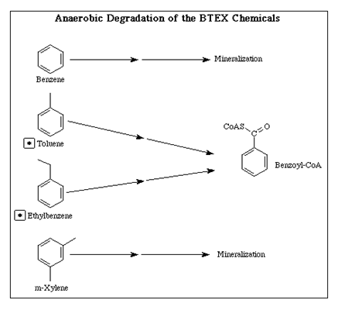
Anaerobic Degradation Pathway

Slide 15
Chemical Oxidation
Chemical oxidation can transform BTEX compounds into CO₂ and water in a relatively short period of time
Injections wells are used
Chemicals can be pumped into the wells or can be injected under high pressure
Soil conditions determine which method will work best
Chemical oxidation is often used with soil vapor extraction (SVE)

Slide 16
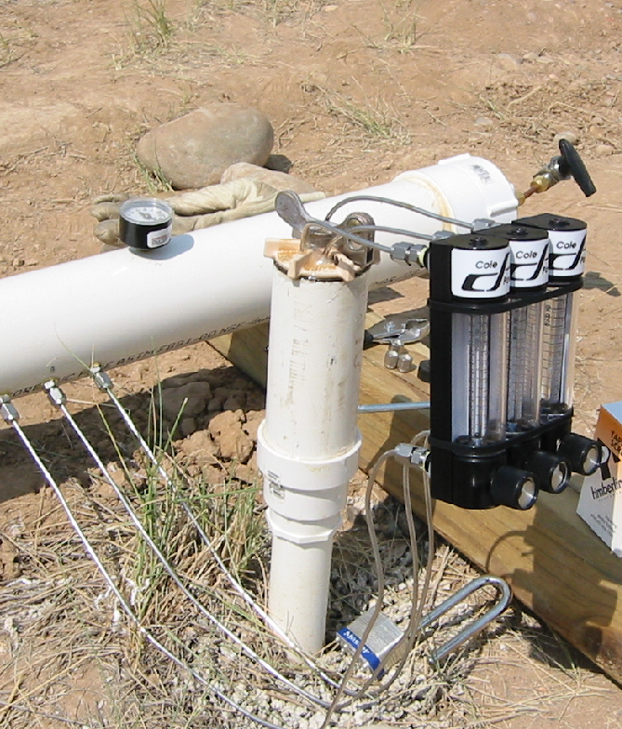
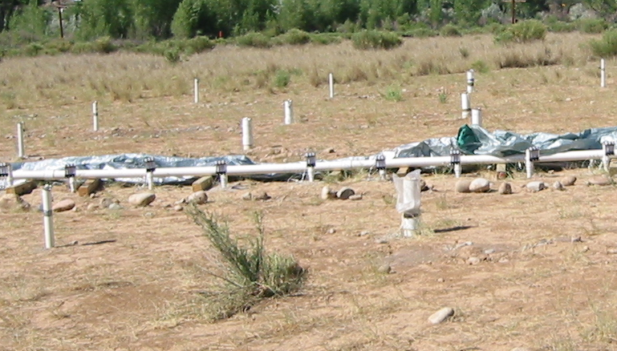
Injection Wells
Right: Injection well
Below: Field of injection wells

Slide 17
Chemical Oxidation
Numerous chemicals can be used, hydrogen peroxide is the most common
Hydrogen peroxide decomposes into water and oxygen providing the oxygen needed to break chemical bonds
Oxygen not used to break chemical bonds will increase DO levels in the sub-surface environment promoting microorganism growth
Hydrogen peroxide is often used with a ferrous catalyst known as fenton’s reagent

Slide 18
Chemical Oxidation
The main limitation for chemical oxidation is cost
Thousands of gallons can be used at one site
Must be monitored during injection
Temperature, pH
The formation of toxic secondary products must also be monitored
Surrounding buildings must be monitored for VOC’s in their basements
Soil conditions must be taken into consideration

Slide 19
Adsorption
A relatively new technology that is being applied to industrial wastewater
BTEX can be adsorbed with macroreticular resin
Process requires contaminated water to pumped through adsorption column
Process can be continuous or in batches
Adsorption works well for water with concentrations so high that BTEX acts as an inhibitor
BTEX can be recovered from the resin

Slide 20
Conclusions
There are numerous methods to remediate sites contaminated with BTEX
Soil conditions are very important when determining the best technologies to apply
More than one technology is often required to meet standards
It is much better and cheaper to prevent contamination than try and deal with it later

Slide 21
Questions
? ? ?

