Slide 1
Introduction to the Wind Energy Science, Engineering, and Policy (WESEP)
Real-Time Research Collaborative (RTRC)
J. McCalley
WESEP 594 (EE 594B)
January 17, 2013

Slide 2
Overview
What it is
Motivation
Status of WESEP PhD program approval process
Why WESEP PhD program will be successful
Housekeeping
Planning
Overview of WESEP 594

Slide 3
What it is: overview
A PhD degree program, like EE, ME, … but not a department
Interdepartmental: grad faculty from different departments
Aerospace Engr
Geological & Atmospheric Sciences
Agronomy
Electrical & Computer Eng.
Materials Science Eng.
Industrial & Man Systems Eng.
Sociology
Economics
Statistics
Journalism & Communications
Civil, Con & Environmental Eng., Mechanical Eng.
Research structure is by following thrusts:
Wind resource characterization & aerodynamics of wind farms
Wind energy conversion system and grid operations
Manufacturing, construction, and supply chain
Turbine reliability & health monitoring
Economics, policy and public perception
Admitted applicants must have calculus-based UG or MS training. It is expected that most admitted applicants will come with UG and/or MS degrees in math, engineering, economics, statistics, atmospheric sciences.

Slide 4
What it is: WESEP Faculty
Name | Role | College | Discipline | Expertise
1.Jim McCalley | ISUAdmCom/Fac | COE | Electrical Engr | Pwr systems, plnng
2.Lisa Brasche | ISUAdmCom/Fac | COE | Materials Science Engr | NDE, indust coordntr
3.John Jackman | ISUAdmCom/Fac | COE | Ind. & Mfg. Sys Engr. | Manufacturing
4.Partha Sarkar | ISUAdmCom/Fac | COE | Aerospace Engr | Aerodynamics
5.Gene Takle | ISUAdmCom/Fac | CALS | AtmSci, AeroE, Agrnmy | Wind/climateScience
6.D. Aliprantis | ISU Fac | COE | Electrical Engr | Pwr elctrncs&gen
7. V. Ajjarapu | ISU Fac | COE | Electrical Engr | Power systems
8.Bruce Babcock | ISU Fac | CALS | AgEcon,CntrAgRralDev | Ag econ, Policy
9.Carmen Bain | ISU Fac | CALS | Sociology | SocScience of tech
10.Nicola Elia | ISU Fac | COE | Electrical Engr | Control systems
11.Bill Gallus | ISU Fac | CALS | AtmSci | Wind science
12.Agustin Irizarry | UPRM Fac | COE | Electrical Engr | Pwr systems, rlbty
13.Mike Kessler | ISU Fac | COE | Materials Science Engr | Composites
14.Catherine Kling | ISU Fac | LAS | Economics | Env econ & policy
15.Bill Meeker | ISU Fac | LAS | Statistics | Reliability
16.Frank Peters | ISU Fac | COE | Ind. & Mfg. Sys Engr. | Manufacturing
17.Lulu Rodriguez | ISU Fac | LAS | Journalism & comm | Communications
18.Sri Sritharan | ISU Fac | COE | Civil, Const & Env Engr | Tower/foundation
19.Judy Vance | ISU Fac | COE | ME, VR Application Ctr | Virtual reality
20.Lizhi Wang | ISU Fac | COE | Ind. & Mfg. Sys Engr. | Incentive desgn,OR
21.Antonio Conejo | Int. collabratr | UCLM | Electrical Engr | Pwr systems, OR
22.N. Meyendorf | Int. collabratr | FID | Materials Science Engr | Non-des eval
23.Soren Larsen | Int. collabratr | RISO/DTU | Atmospheric Science | Wind resrce assmt
24.Mark O’Malley | Int. collabratr | UCDublin | Electrical Engr | Pwr systems, wind
25.Qing Xia | Int. collabratr | Tsinghua | Electrical Engr | Elctrcty mrkts,wind
WESEP Interdepartmental Faculty
International partners
“To be awarded a degree in Wind Energy Science, Engineering, and Policy, a student’s major professor must be a member of the Interdepartmental WESEP faculty. Any faculty member at Iowa State University who is actively involved in wind energy-related research and graduate education may apply for membership in WESEP. Membership must be renewed every five years.” - WESEP Gov Document

Slide 5
What it is: program requirements
Required Courses Credits
Level 1:
WESEP 501 3
WESEP 502 3
Level 2:
Primary Thrust Area (4 courses) 12
Secondary Thrust Area (3 courses) 9
At least 1 public policy course (econ/policy/comm) 3
Level 3:
. Advanced Specialization (WESEP 511or 512) 3
Total course credits: 33
Research (699) 39
Total Graduate Credits 72
Students are also required to
pass a qualifying examination in the first 18 months of their program,
pass a preliminary examination (generally taken between 18 and 36 months),
write a scholarly dissertation with significant contributions to the archived literature
defend the dissertation in a final oral exam (generally by the end of year 4).

Slide 6
What it is: 5 thrust areas for resrch & courses
Thrust 1: Wnd rsrc chrctrztn & ardyn of wnd frms
Agon 505 Environmental biophysics
Mteor 507 Mesoscale meteorology
Mteor 605 Micrometeorology
EnSci 381/382 Environmental systems I, II
AgEds 451 Agricultural law
EE 553 Power System operation
AerE 541 Incompressible flow ardynam
AerE/ME 546 Comp fld mech/heat trnsfr
AerE 570 Wind engineering
AerE/EM 570 Wind engineering
AerE 572 Turbulence
Thrust 2: Wind energy cnvrsn sys & grid oprtns
AerE 541 Incompressible flow ardynam
AerE/ME 546 Comp fld mech/heat trnsfr
AerE 580* Wind turbine aerodynamics
AerE 522 Vibrations & aeroeleasticity
ME 543 Intro to rand vibs/nnlinr aerdyn
EE 552 Power system planning
EE 553 Power system operation
EE 554 Power system dynamics
EE 556 Power electronic systems
EE 559 Elctrmchncl wind energy conv&grid intgrtn
EE 577 Linear systems
EE 578 Nonlinear systems
ME 517 Advanced machine design
AerE 580* Wind turbine aerodynamics
IE 531 Linear programming
IE 510 Network analysis
IE 534 Linear programming
IE 631 Nonlinear programming
IE 632 Integer programming
Thrust 3: Mnfctrng, cnstrction & supply chain
AerE/EM 514 Advance mechanics of materials
AeroE 525 Finite element analysis
CE 533 Structural steel design II
CE 534 Reinforced concrete design II
CE 561 Applied foundation engineering
CE 460 Foundation Engineering
CE 535 Prestressed Concrete Structures
CE 541.Dynamic Analysis of Structures
IE 503 Intro to sustainable production systems
IE 514 Production scheduling
IE 543 Wind energy manufacturing
IE 541 Inventory cntrl & production planning
IE 546 Geometric variability in manufacturing
IE 549 Cmptr aided design & manufacturing
ME/EM 564 Fracture and fatigue
ME 520 Material & manufctrng in design
MSE 554 Polymer composites & processing
MSE 569 Mchncs of composite/combined mtrls
SCM 522 Supply chain planning & control systems
Thrust 4: Reliability and health monitoring
EM/MSE 550 Fundamentals of NDE
MSE/EE 588 Eddy current NDE
EM 551 Fund of ultrasonic NDE engr
Stat 500 Statistical methods
Stat 511 Statistical methods
Stat 533 Reliability
Stat 542 Theory of probability and statistics I
Stat 543 Theory of probability and statistics II
Thrust 5: Wind econ, policy,& public perception
Econ501 Microeconomics
Econ 581 Advanced Environmental Econ
Econ 580 Intrmdite Envrnmntl/resource econ
Econ 537 Cmmdty Mrkts: Analysis & Strategy
Jl MC 547 Science communication
Jl MC 560X Risk perception & communication
Soc382 Environmental sociology
Soc415 Sociology of technology
Soc 549 Sociology of the environment
You can suggest courses to add to this list; it will be considered and voted on by WESEP Supervisory committee:
AeroE 481, Advanced Wind Energy: Technology and Design
IE 508, Design and Analysis of Allocation Mechanisms
Metr507, Mesoscale Meteorology

Slide 7
What it is: overview of curriculum
LEVEL 1: INTRODUCTORY COURSES (BREADTH)
Students take both WESEP 501 and 502
WESEP 501 (Agron 590)
WESEP 502
Cognitive approaches, team-based research, leadership, ethics, communications
Every year
LEVEL 2: CORE COURSES (DEPTH AND BREADTH)
Students take 4 courses in major thrust, 3 in secondary thrust
WESEP 594 (EE 594B)
Real-Time Research Collaborative
(1 credit course taken every semester)
Thrust 1 Courses
Thrust 2 Courses
Thrust 3 Courses
Thrust 4 Courses
Thrust 5 Courses
Level 2: POLICY COURSE*
Econ, PolySci, Soc, JLMCC
Every sem
LEVEL 3: SPECIALIZATION COURSES (DEPTH)
Students select one of WESEP 511 or 512
WESEP 511
Every 3rd sem
WESEP 512
*If policy is a secondary area, then Level 2 course is chosen out of a thrust not major or secondary.

Slide 8
What it is: non-major, co-major options
You can take courses without being in WESEP degree program
You can co-major, but you must satisfy requirements of both majors; in many cases, requirements will overlap.
“A co-major is a program of study for a single degree in which the requirements for two separate majors are met. A single degree is granted when the student fulfills the requirements of both majors. The program of study (POS) committee will include co-chairs, each of whom represents one of the co-majors. Both co-chairs must be members of the graduate faculty. The same person, if a faculty member in both majors, will be allowed to serve as major professor for both majors. A preliminary oral examination and research work for the Ph.D. degree should be related to both majors. Students declaring co-majors must satisfy requirements established by each major as monitored by the representatives on the program of study (POS) committee and the DOGEs of the two majors. A co-major cannot be added after the preliminary oral examination has been taken.”
- ISU Graduate College Handbook, www.grad-college.iastate.edu/common/handbook/
“To be awarded a degree in Wind Energy Science, Engineering, and Policy, a student’s major professor must be a member of the Interdepartmental WESEP faculty. Any faculty member at Iowa State University who is actively involved in wind energy-related research and graduate education may apply for membership in WESEP. Membership must be renewed every five years.” - WESEP Gov Document

Slide 9
Motivation 1
Wind energy has had second fastest growth, in electric resource capacity, in GW, every year since 2005.
Iowa is second in the nation in installed wind energy capacity.
Electric growth, environmental concerns, economics , US policy suggest wind energy will continue to play dominant role in needs of new electric resources in world, US, Midwest, & Iowa.
Wind turbine technology is in its infancy – it must develop along multiple dimensions over the next 40 years.
Wind energy is a highly interdisciplinary area, requiring knowledge in multiple engineering disciplines, atmospheric sciences, agriculture, statistics, and socio-economics.
The program is consistent with ISU’s mission, its strategic plan priority, and the COE strategic plan
US is behind in providing advanced degrees in this area….

Slide 10

Motivation 2
Department of Energy (DOE) indicated in a recent report US wind power can reach 300GW by 2030, with Iowa being a major contributor. This same report stated that
“…the level of US graduate programs is well below similar graduate programs in Europe (Denmark, Germany, etc). At this rate, the United States will be unable to provide the necessary trained talent and manufacturing expertise. Unless this trend is reversed, even with major new wind installations in the United States, most of the technology will be imported, and a significant portion of the economic gains will be foreign rather than domestic.”
Other predictions suggest as much as 600 GW by 2035

Slide 11
Motivation 3
➔We expect high student demand:
Similar PhD program at Texas Tech, and at Strathclyde, Penn State and others are considering.
High student demand for other wind-related activities
  AeroE 381, Intro to Wind Energy, 60 in Sp2010, 55 in Sp2011
  AeroE 481, Advncd Wind Energy- Technology & Design
  Engr 340, Wind Energy system design & delivery: 27, fall2012
  EE 559, Electromech wind energy con & grid op: 17 in sp 2009, 20 in fall 2010, and 24 sp2012
  IE 543, Wind energy manufacturing, 24 sp2010, 11 sp2012
  ISU Wind Energy Summer REU program
    2011: 270 applicants for 11 positions;
    2012: 150 applicants for 10 positions.
    2013: ????

Slide 12
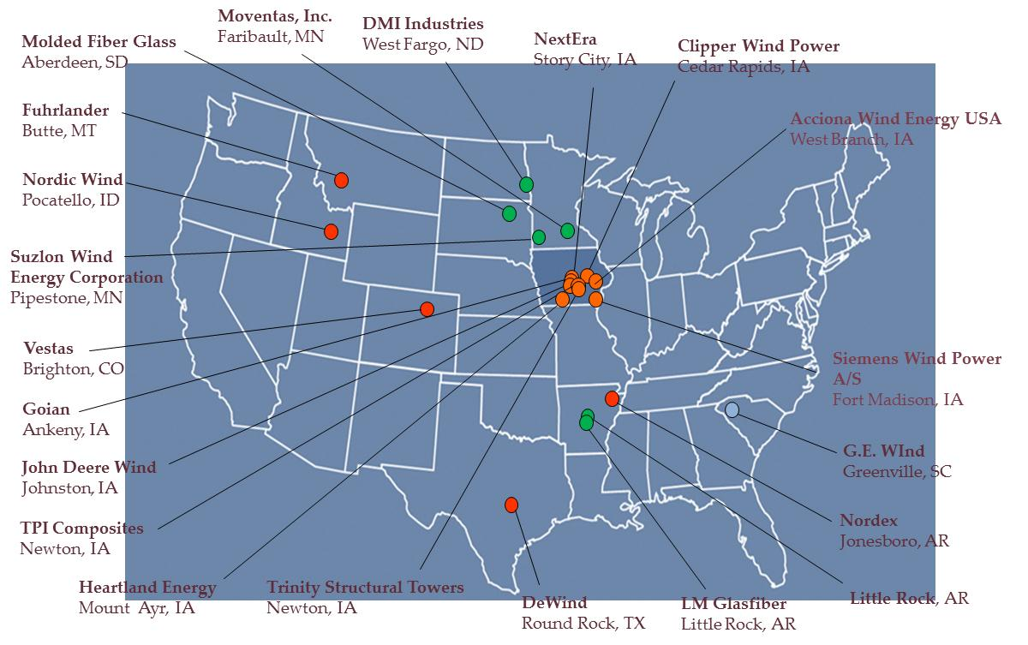
Motivation: Industrial support
“We strongly endorse the proposed idea of establishing a PhD program in Wind Energy Sciences, Engineering and Policy (WESEP) at ISU, as there is a strong need in the industry for graduates having a PhD in WESEP, reflecting the interdisciplinary nature of the wind energy business.”
-Jianhui Wang, Argonne National Lab
“GE EA&SE currently employs over 20
professionals at the PhD level, and we think it likely that we would make between 5 and 10 new PhD
hires over the next 5 years. I would expect that graduates of the proposed ISU WESEP PhD program to
compete very well for many of these positions.
-Hamid Elahi, GE EA&SE

Slide 13
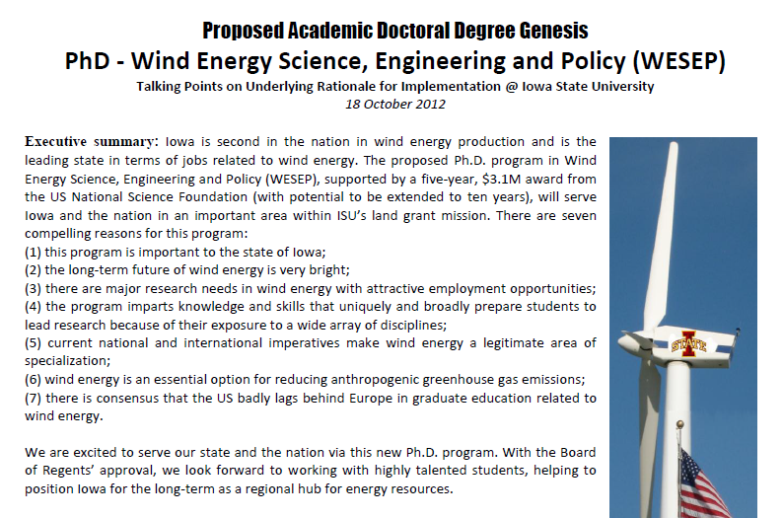
Motivation: See posted document
home.eng.iastate.edu/~jdm/wesep594/index.htm

Slide 14
Status of WESEP PhD Approval Process
Participating departments & colleges
University of Iowa and UNI
Graduate college
Academic affairs council
Faculty senate, to occur on 9/11/12
Board of Regents 12/5/12
DONE
Acknowledgement: Professor John Jackman

Slide 15
Why WESEP will be successful
Student demand is here
Industrial, academic, government demand is here
There is strong support support from COE admin (one of 3 $500k Venture Fund activities); its interdisciplinary nature makes it attractive to university admin
Financially strong research base at ISU:
  A $3.1M, 5-year NSF IGERT, renewable w/more $ to 10 yrs
  Several DOE projects, state projects, industry projects
Very healthy industrial support
Although today’s politics suggest Federal support for wind may diminish in next few years, long-term demand for clean energy is unavoidable, ultimately resulting in heavy wind-reliance

Slide 16
Why WESEP will be successful
The WESEP PhD degree crosses boundaries between
Atmos science, Econ, Statistics, Engr, Policy, Finance
Within engineering: AE, CE, EE, IMSE, ME, & Materials
And so this degree will enable you to work effectively across all of these boundaries.
Perhaps of more importance, we intend to provide you with a foundation of “boundary crossing,” enabling you to work effectively in the seams of different disciplines that you will encounter in the future.

Slide 17
Housekeeping: Room and Computer
Room 1131, Coover:
“WESEP Community Learning Center”
See Barb to obtain key
Will purchase computer for your desk if you need it
Office in Coover vs in the building of home department:
  Strength: proximity to other WESEP students
  Weakness: remoteness from advisor
  Take advantage of strength, compensate for weakness
    ➔ Interact heavily with this group of IGERT fellows
    ➔ Have arranged meeting times with advisor

Slide 18
1131 Coover Hall
Desk #7
Joseph Slegers
Desk #12
Empty
Desk #5
Empty
Desk #2
Santiago Lemos
Desk #11
Ashley Mui
Desk #3
Vasiliki Dimitra
Desk #8
Nick Brown
Desk #4
David Jahn
Desk #6
Huiyi Zhang
Desk #1
Hugo Villegas
Desk #9
Michael Johnson
Desk #10
Empty

Slide 19
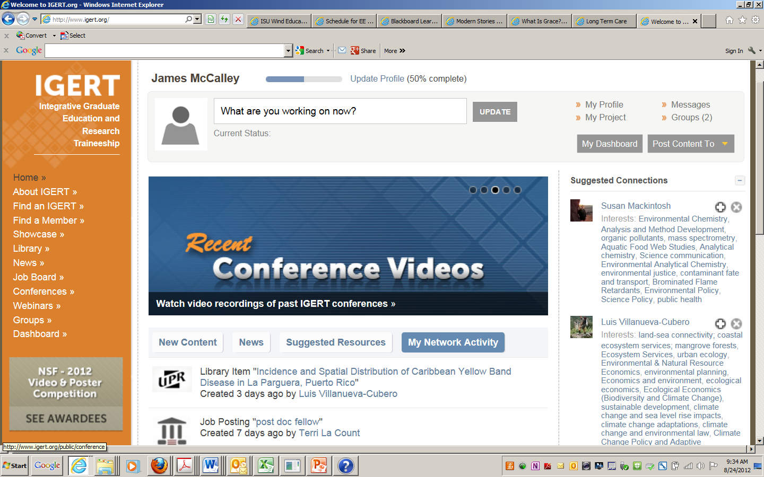
Housekeeping: Register on IGERT.ORG

Slide 20
Housekeeping: Register on IGERT.ORG
Students, faculty, and AdminCoordinator (Barb) should register:
Promotes collaboration between projects (poster contest, webinar tool is available with free phone conference line, speakers and seminars can be streamed, they can record and post videos)
Share resources (news, job-board, conference calendar) so that all IGERT students and faculty can benefit from them;
Dissemination and outreach. In the library, you can post the abstract of the publication and then link to the journal and these articles will rise to the top that are presented, highlights, achievements, and “stories” can be placed in the “Showcase”
Networking: they have an algorithm to connect people. Also, you can put your external website there and you will get more hits.
Students will have to submit IGERT annual reports.
Use contact@igert.org to ask questions about how to use IGERT.org.

Slide 21
Planning: Typical time line
A 4-year “time-to-degree” is typical but a student may take somewhat more or less time.
You should fill this table yourself with exactly which course you will take and when.
Check with department to ensure you know when they will be offered.
Time | Courses | PhD | Visits
Semesters 1,2 | 501 and 502; 4 cores
Summer 1 | *
Semesters 3,4 | 511 or 512; 4 cores | Qualifier exam
Summer 2 |  |  | International experience#
Semesters 5,6 | * | Preliminary exam
Summer 3 |  |  | Industry internship#
Semesters 7,8 | *
Summer 4 |  | Final defense
* You may want to take more courses. You may also want to delay taking some core courses until these semesters. This decisions is to be made by you and your advisor.
# You may like to reverse the order of these visits. This decisions is to be made by you and your advisor.

Slide 22
Planning: Research topic
To obtain WESEP PhD, choose a wind energy topic.
You and advisor must agree on the topic.
You are encouraged to identify one or more companies who will be interested in your dissertation work.
  Mid-term or long-term interests are preferred;
  We desire to work collaboratively with industry;
    Monthly or quarterly conference calls strongly encouraged
    Facilitates internship opportunity and the potential for that opportunity to facilitate and enrich the research
  Use “Project spreadsheet” in considering your topic choice

Slide 23
Planning: dissertation as “living” draft
Have draft1.0 of dissertation by Feb 1, 2013:
  Thrust area, topic, objective, chapter headings
  Some literature review
Have draft2.0 of dissertation by Aug 15, 2013:
  Thrust area, topic, objective, chapter headings
  Significant literature review
  Chapter 1, including high-level articulation of your approach
  A research plan for next three years
  Initial draft of qualifier (should become part of dissertation)
Additional comments:
  Advisor should be aware of/involved in your planning
  Turn into WESEP supervisory committee (John Jackman)
  A dissertation draft in year 1?!!!!
  ➔Better to have a plan and change it than not have a plan
  ➔Living draft: good way to maintain your current thinking
  ➔Avoids stress of “writing an entire book” at the end

Slide 24
Planning: qualifier
Student writes paper with advisor and submits by end of third semester. (Some flexibility can be extended on this for “direct-entry” students at the request of the advisor). Can be a part of dissertation draft3.0. Student gives 30 minute oral presentation of paper before Qualifier Committee (QC). A student not passing can repeat if QC so recommends. No third attempts.

Slide 25
Overview of WESEP 594
NSF: ISU’s grad education should change as a result.
WESEP PhDs required to take it each semester
4 year program ➔ Take this course 8 times.
Objective: To enhance students’ research skills in Wind Energy Science, Engineering & Policy (WESEP)
Intended to complement your research efforts
  Instruction on how to do research
  Opportunities to collaborate
  Tangible outcomes: proposals and papers!
It is more than a 1 credit course: you are the heart of the WESEP program, and this course is a very central tool to use in making it successful.
It is a Real-Time Research Collaborative!

Slide 26
WESEP 594 Activities
1. Span entire research cycle in interdisciplinary teams:
Teams of 3-4 students formed with each team responsible for conducting a complete research cycle throughout the semester, including developing a proposal, conducting the research, and documenting the research in a publication.
Each team presents twice each semester, a “midstream” presentation following completion of their proposal, and a final presentation of the resulting publication.
It is encouraged that ultimately:
  proposals would be submitted to a funding agency and
  publications would be submitted to a conference/ journal.
View this as opportunity to strengthen your dissertation.
Review list of topic suggestions from industry/faculty.
Most topics contain components out of your discipline.

Slide 27
WESEP 594 Activities
1. Span entire research cycle in interdisciplinary teams:
This semester, the topic is “policy.”
Federal PTC/ITC is an obvious target but not the only one.
Others include
  Interdependencies with other federal policies, e.g., CAIR, CSAPR, MATS
  CO₂ legislation and regulation
  State legislation and regulation
  Regulation related to birds/bats
  Transmission regulation
  Public support
  Communication efforts

Slide 28
WESEP 594 Activities
2. Broaden cognitive approaches:
Seasoned researchers will provide lectures on how they “do” research; how they think while doing it, addressing:
How do we become aware of the problems we work on?
What are the attributes of a “good research problem”?
To what extent can research be planned?
What is the interplay between creativity and literature review?
What is the desired “end-product” of a research project (paper? “contribution”? patent? technology transfer? impact? graduated student?); how in the research process does choice of “end-product” affect what happens?
When does bottom-up and top-down thinking yield their greatest potential?
How are solution approaches identified?
What constitutes acceptable evidence that a problem is indeed solved?
What organizational structures and modes of human interaction are effective in facilitating research?
Presenters to bring 1 or more existing students to write reflections (not assess) on what they think is most effective.
Presenter is encouraged to share this with class via email.

Slide 29
WESEP 594 Activities
3. Develop leadership skills:
2 classes/semester to be dedicated to ethics, communication, and leadership issues. These classes will be led by
ISU journalism professor and communication expert Dr. Lulu Rodriguez
ISU philosophy professor and ethicist Clark Wolf
This activity is central to the WESEP program because high wind penetration will lead to complex human interactions between landowners and land managers, manufacturers, utilities, regulators, state and federal agencies, policy-makers, ecologists, and non-government organizations.

Slide 30
WESEP 594 Activities
4. Industry lectures:
Several lectures will be given by individuals from industry, focused on research areas being addressed by students in the course (see #1 above).

Slide 31
WESEP 594 Activities
5. Workshop preparation:
Develop a July 2013 workshop on policy and other social-science issues
NSF will fund on condition that it is organized by you!
Two NSF programs are interested and willing to fund:
  IGERT (Carol Stoel)
  EFRI-RESIN (Bruce Hamilton/Joy Pauscke)
There are eight $2M RESIN research teams will attend
There should be other IGERTs interested.
On-campus organizations will also fund:
  Bioeconomy Institute (Robert Brown)
  Wind Energy Initiative (Sri Sritharan)
There are several ISU social scientists interested

Slide 32
WESEP 594 Activities
Bruce:
As you know, I also have an IGERT on Wind Energy Science, Engineering and Policy. This afternoon I had a conversation with Carol Stole who is my program manager for my IGERT. At one point in the discussion, she suggested I organize a summer workshop on wind energy, and if I did that and included 2-3 other IGERTs around the country, it would be possible to fund it through a supplement. I mentioned to her the interest in possibly organizing an EFRI-RESIN workshop in the summer, and she indicated it might be a very natural fit and that it might be possible to consider co-funding it between IGERT and EFRI.
So here is how I am now thinking about it:
- 1 day EFRI-RESIN workshop
- 1.5 day conference, with papers on “Sustainable infrastructures”
- Focus of both the workshop and the conference will be on policy and social-science issues.
How does this strike you?
=======================================================================
Hello Jim, Rose, Sohi, and Joy,
Jim, many thanks for your message below. I very much like the idea of IGERT and EFRI co-funding such a supplement for a workshop. I really like a whole bunch that the "Focus of both the workshop and the conference will be on policy and social-science issues." As just discussed at RESIN Workshop #4, this is, as you know, of critical importance for major advances in research on sustainable and resilient infrastructures. I assume that you would have a good complement of social scientists as participants in the workshop/conference that you are proposing, along with RESIN engineers. I also like the idea of REU participation (although to work well this would probably require some careful planning about how exactly to involve the undergraduates in a productive way). As an EFRI/RESIN program officer, I would recommend EFRI co-funding, but such a recommendation would have to have the concurrence of the EFRI Office Director, either Rose Wesson or Sohi Rastegar. Additionally, your actual EFRI program officer, Joy Pauschke, would probably have to recommend co-funding.
Rose, Sohi, and Joy, what do you think about Jim's idea as described in his message below?
Best wishes,
Bruce Hamilton
CBET/ENG and EFRI

Slide 33
Workshop – what you need to do
Choose a workshop chair
Develop a workshop budget
Submit NSF supplement request
Develop an organizing “organization” with specific people in charge of specific things
Identify basic workshop structure
Develop a website
Communicate it to right groups

Slide 34
Workshop – what you need to do
Choose a workshop chair
Develop a workshop budget
Submit NSF supplement request
Develop an organizing “organization” with specific people in charge of specific things
Identify basic workshop structure
Develop a website
Communicate it to right groups

Slide 35
Homework for next week
These course website is
home.eng.iastate.edu/~jdm/wesep594/index.htm
Identify research teams and topics
Choose a workshop chair and develop budget

