Slide 1
Wind Energy Science, Engineering, and Policy (WESEP) Real-Time Research Seminar (RTRS) Discussion Questions Spring Semester, 2014
J. McCalley
WESEP 594
February 13, 2014

Slide 2
Overview
Remaining schedule for WESEP 594
Comments on faculty seminars in WESEP 594
Comments on industry lectures in WESEP 594
Your presentations
Your summer plans
Industry engagement
Your research
Open discussion

Slide 3
Remaining schedule for WESEP 594
http://home.eng.iastate.edu/~jdm/wesep594/

Slide 4
Comments on faculty seminars in WESEP 594
Spend just a few minutes identifying your particular research area with respect to WESEP and in particular identify one or more “open” research questions of which you are aware. This would help the students get to know you, and it will help them in their need to identify a research problem for the semester.
Spend the bulk of the time describing how you “do research” and how you think when you do it. I realize this may not be so easy, and so I have developed a series of questions below for you to address if you like, although you do not have to address all of them (or even any of them) and you can certainly address other questions and issues if you so prefer and think that in doing so you will be better able to convey how you “do research.” It is my hope that you will make effort to see inside your own mind as it functions in the research process, and then try to articulate what you observe.
There were four of us who did this in Fall 2012: McCalley, Takle, Jackman, Brasche; four did it Spring 2013: Sarkar, Peters (but did not use slides), Sritharan, and Rajagopalan; and three did it in Fall 2013: Meeker, Jiles, and Gallus. You will find some of the corresponding slides at http://home.eng.iastate.edu/~jdm/wesep594/. The thought is, at the end of the WESEP Ph.D. student’s four years here at ISU, he/she would have heard about 32 faculty articulate how they do research.

Slide 5
Comments on faculty seminars in WESEP 594
The objective of this is to help the student broaden their cognitive approaches:
Seasoned researchers provide lectures on how they “do” research, and
how they think while doing it, addressing, for example, some of the following questions…
How do we become aware of the problems we work on?
What are the attributes of a “good research problem”?
To what extent can research be planned?
What is the interplay between creativity and literature review?
What is the desired “end-product” of a research project (paper? “contribution”? patent? technology transfer? impact? Graduated student?); how in the research process does choice of “end-product” affect what happens?
When does bottom-up and top-down thinking yield their greatest potential?
How are solution approaches identified?
What constitutes acceptable evidence that a problem is indeed solved?
What organizational structures and modes of human interaction are effective in facilitating research?

Slide 6
Comments on industry lectures in WESEP 594
Possibilities:
Wayne Galli, Clean-Line Energy Partners
Manager of GE WT aero blade design team
Parveen Baig, engineer for Iowa Utility Board
Bruce Gamble, Chief Engineer, American Superconductor
Robert Duckworth, Oak Ridge National Lab
Jonathan Lynch, Northern Power

Slide 7
Your presentations
Each student to provide presentation: two presenters per class
Presentation should focus on their research:
objective, motivation, your research plan, what you have done so far, what you will do
Central, fundamental concepts underlying your work: TEACH US!
➔ relationships/connections to the work of other WESEP students
Presenter selects technical paper; distributes 1 week in advance together with dissertation topic
➔Paper to provide foundational background for important element(s) of the disst topic
➔All WESEP 594 students to read paper to gain background and prepare for seminar
Each presenter has 20 min + 5 min Q&A
Rest of the class provides “Response” (< 1 pg) by end of class:
How does the work relate (or could relate) to my own disst work?
How does the work relate (or could relate) to the disst work of other WESEP students?
What are the strengths of this research?
How could the research be enriched/improved?
Show your advisor your slides
Invite your advisor to attend

Slide 8
Your summer plans
Work on your research: may be the way to go for first year students (but there are no rules that it must be so)
Go on an international experience: Can be extremely valuable if you identify the right organization. Might be less valuable if you do not. It is an opportunity to establish relationships of value to you for the rest of your career. Do web search. Discuss with advisor. IGERT pays for this.
Get a summer internship: All of what is said in #2 is true here as well, except:
IGERT does not pay for this; company should pay;
Helps to establish Engagement.

Slide 9
Industry Engagement
We will strongly encourage such involvement to include serving as advisors via quarterly conference calls where the faculty and student researchers provide a 30 minute overview of their progress, and advisors provide feedback. This would serve as an initial step towards further collaboration, to include:
Student internships on-site with the industry organization;
Future funding of our work on the part of the PAB member;
Future joint efforts to obtain funding from state or federal agencies;
Support of a university center, an ISU Wind Energy Laboratory, and ultimately an NSF center proposal

Slide 10
Industry Engagement
ISU Summary Document:
Originally sent to MidAmerican Energy per their request
I have updated it a bit since then
Added “Graduate students involved”
Guessed where your name should be
Find your name and identify for me whether the identified project is adequately describing your work, and also identify whether any other project is more effectively describing your work. Then, within the next week, please consider if you would like to enhance the description of your work. Ways you might do this include:
Move your name to another project description;
Modify the description where you find your name (if you do this, please use “Tracking”!);
Add a new project description which fits your work.
Whatever you do, it will be wise to discuss with your advisor before you send it back to me. Note that I am planning to send the “ISU Summary” document to the PAB with intention of identifying at least one “industry project advisor” for each of you. If I am successful in this effort (and I will try very hard to be successful), then my intention is that you would be periodically sending this individual short summaries of your work, and/or giving telephone presentations to him/her, and/or discussing with him/her about having an internship.

Slide 11
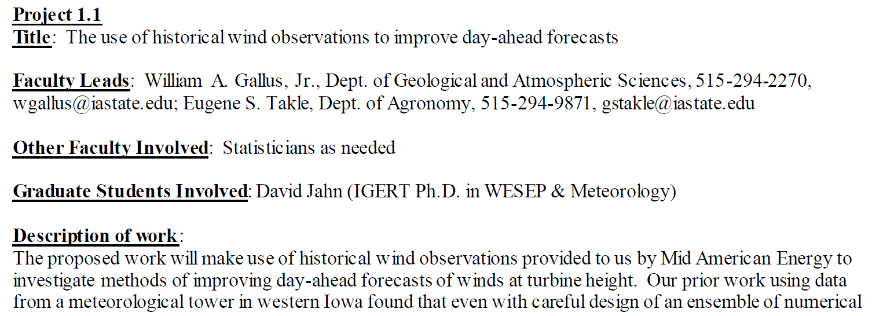
Industry Engagement

Slide 12
Industry Engagement
A project description should be no more than 1 page and less is good.
Your advisor should be in agreement.
Your name could appear on more than one project but would rather not.
Is there another company you would like to have on the project advisory board?

Slide 13
Your Research
What are you worried about?
What is going well?
What is not going well?
What would help you most?
Do you see a research plan?

Slide 14
Open discussion
Any other thoughts?

