Slide 1
Modification of a Mesoscale Model Planetary Boundary Layer Parameterization Scheme for the Numerical Forecast of Wind Ramp Events within a Stable Boundary Layer
David E. Jahn
WESEP594
Fall 2013
Wind Energy Science Engineering and Policy (WESEP) Program
Iowa State University

Slide 2
Background
With continued increase in wind power integration as part of the US electric grid, wind variability is of concern.
Wind ramps present the need to plan for a relatively large upswing/downswing in wind power occurring over a relatively short time
  Value for day-ahead market planning to schedule anticipated unit generation, including wind power, to meet forecast load
  Value for near real-time operations, with updated wind forecast in order to anticipate need to bring on-line slow start-up units several hours before an anticipated ramp
  Goal: maintain generation that matches load and alleviate fluctuations in power frequency
There is need for accurate wind forecasts at turbine height, from several hours ahead to several days ahead

Slide 3
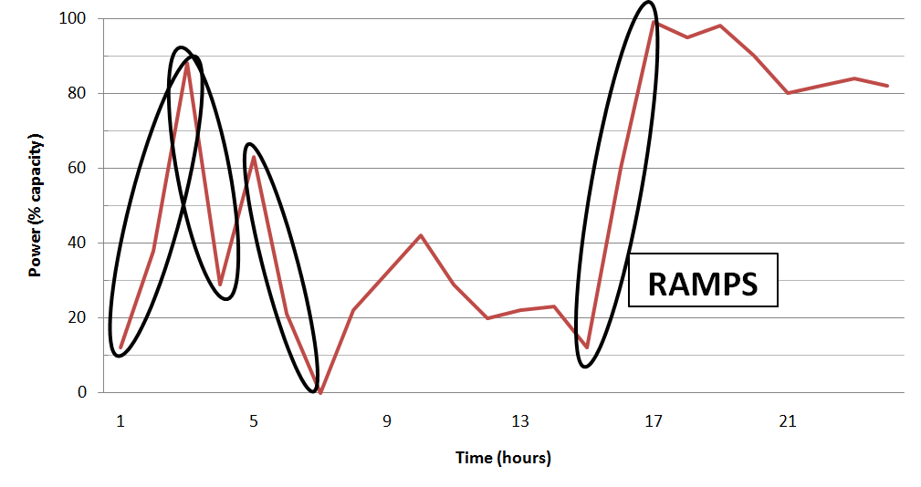
Definition of Wind Ramp
Change in power > 50% wind power capacity within 1-4 hours (depending on respondent)
Background
Figure taken from Ferreira et al. (2010)

Slide 4
Definition of Wind Ramp
For 1.5MW turbine, a wind ramp translates to a change in wind 3 m/s over 1-4 hrs.
In this study, used change of >= 3 m/s in <= 1 hr.
Figure taken from Deppe , Gallus & Takle (2013)

Slide 5
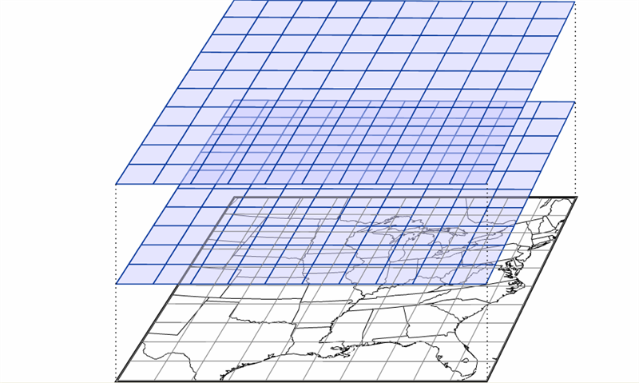
Numerical Weather Prediction (NWP)
Mathematical model based on governing equations representing: laws of conservation of energy, mass, and momentum (i.e, the Navier-Stokes equations)
Model equations are discretized for execution on a 3D gridded domain
Meteorological variables are
calculated at each gridpoint (winds, temperature, moisture & precipitation)

Slide 6
NWP: Subgrid Parameterizations
Model explicitly solves for variables P, T, wind, moisture/precip. for atmospheric processes resolved by the grid. For 10-km grid resolution this includes frontal boundaries and storm complexes.
The processes not resolved by grid (sub-grid), such as turbulence, must be parameterized.
Planetary Boundary Layer (PBL) parameterization schemes represent the surface effects on the overlying atmosphere including the vertical flux of heat, moisture, and momentum.

Slide 7
Accuracy of Wind Ramp NWP Forecasts
Given that turbine-height is often in the PBL, wind ramp NWP forecasts are sensitive to the chosen PBL scheme
Study by Deppe, Gallus, Takle (2013)
  Evaluated several PBL schemes
    Local mixing scheme (MYJ, MYNN)
    Non-local mixing scheme (YSU)
  General results
    Non-local mixing scheme performed best for 80m height wind forecasts
    Local mixing scheme performed best for wind ramp forecasting
Notes:
Deppe 2013: neg. bias true for all PBL schemes for 12-18 hr. fcst. horiz.
Deppe 2013: positive verif. of ramp event if event occurred within 6 hrs. of time predicted by WRF

Slide 8
Causes of wind ramps
Figure taken from Deppe , Gallus & Takle (2013)
Based on 58 wind ramp cases between 06/08-06/09

Slide 9
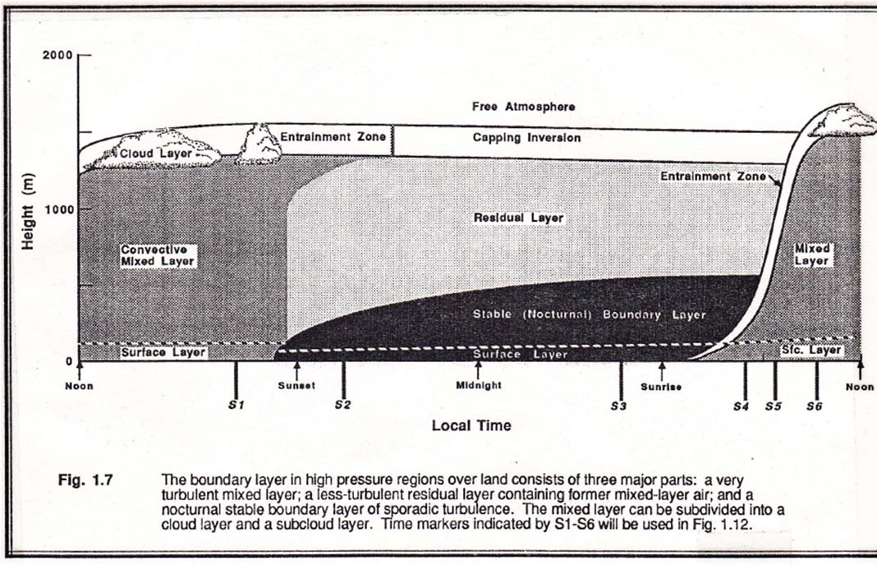
Focus on SBL
Diagram from Stull (1988)

Slide 10
Causes of wind ramps
Figure taken from Deppe , Gallus & Takle (2013)
Ramp events can be caused by various weather situations, each with its own forecast issues.

Slide 11

Impetus: Questions left unanswered
  PBL schemes have been developed as a “one size fits all” approach
  PBL schemes have, for the most part, been tuned for neutral cases
Leaves room for improving PBL schemes:
  Specifically for the stable boundary layer (SBL)
  Specifically for ramp events
www.clker.com
Notes:
“One size fits all”: regardless of very different mechanisms that cause ramp events

Slide 12
Objective
Modify existing PBL schemes to achieve significant improvement in ramp forecasting capability for the SBL
Ramp events not induced by thunderstorms or frontal boundaries
Ramp events associated with a LLJ or internal gravity waves

Slide 13
Goals
Evaluate the theoretical basis of PBL schemes and identify what approximations may/may not be appropriate in consideration of the dynamics of ramp events that develop within the SBL
Modify a PBL scheme to reinstate physical effects that have been neglected or minimized in the original scheme formulation and that are of dynamic significance for ramp events within the SBL

Slide 14
Methodology
Step 1: Revisit PBL scheme theory
Understand the theory of existing PBL schemes as outlined in the key papers of researchers instrumental in scheme development and identify what in their approach is/is not appropriate for the SBL
    MYJ/MYNN schemes (Mellor 1973, Mellor & Yamada 1974, 1982, Janjic 1990)
    YSU scheme (Hong and Pan 1996)
Step 2: Mesoscale model simulations of ramp events and conduct sensitivity studies
Using a mesoscale model simulate select ramp events and conduct sensitivity tests in order to identify prominent coefficients associated with respective numerical terms representing dynamic effects such as turbulence diffusion and dispersion

Slide 15
Methodology
Step 3: LES model simulations of ramp events
Using a large-eddy simulation (LES) model, simulate select ramp events at a high resolution relative to the mesoscale runs
    To gain understanding of small-scale dynamics
    To identify prominent terms of the turbulence governing equations and thus fine-tune PBL scheme coefficients and/or re-instate neglected terms accordingly

Slide 16


Definitions
Wind is represented by its 3 orthogonal components: u, v, w
Reynolds averaging is used to distinguish between the resolved “mean” flow and variations about the mean , referred to as turbulence.
e.g. T = 10 min.

Slide 17




MYJ Scheme: Example Governing Eq. for Mean Flow (Navier-Stokes)
Change in wind
Turb. Energy gradient
Either parameterize directly
OR
Pressure gradient
Solve a system of equations for
Buoyancy
Coriolis
Viscosity

Slide 18

MYJ Scheme: Example Governing Eq. for Mean Flow (Navier-Stokes)
Change in wind
Turb. Energy gradient
Either parameterize directly
OR
Pressure gradient
Solve a system of equations for
Buoyancy
Coriolis
Viscosity
Comparable equation for potential temperature that includes a term

Slide 19












MYJ Scheme: Governing Eqs.
Would need a set of governing equations that would define the change of -like variables such as
A system of 10 differential equations would be required to solve for all turbulent quantities:

Slide 20






MYJ Scheme: Template of Terms for Governing Eqs.
Change in turb. energy
Energy redistribution
Dissipation
Buoyancy term
Diffusion
Shear production
Notes:
Add: Eqs. are needed for ALL turb. energy terms: vw, theta-w, u^2, v^2, etc.

Slide 21







MYJ Scheme: SimplifiedTerms for Governing Eqs.
Change in turb. energy
Energy redistribution
,
Dissipation
Buoyancy term
Diffusion
Shear production
Note:
Notes:
Add: Eqs. are needed for ALL turb. energy terms: vw, theta-w, u^2, v^2, etc.

Slide 22





MYJ PBL Scheme
Comparable equations for:
with arbitrary coefficients
with arbitrary coefficients

Slide 23


Methodology: Sensitivity Tests Based on Mesoscale Modeling
Conduct sensitivity tests for ramp event cases using WRF by systematically varying PBL scheme coefficients
Identify what terms are most influential in PBL scheme (and WRF) solution for SBL ramp event cases
Notes:
List approximations used to simplify the equations.
Most appx. are not addressed in this immediate study, only sensitivities to coefficients.
It is hoped to be able to investigate validity of appx. using LES (very small scale) runs.

Slide 24
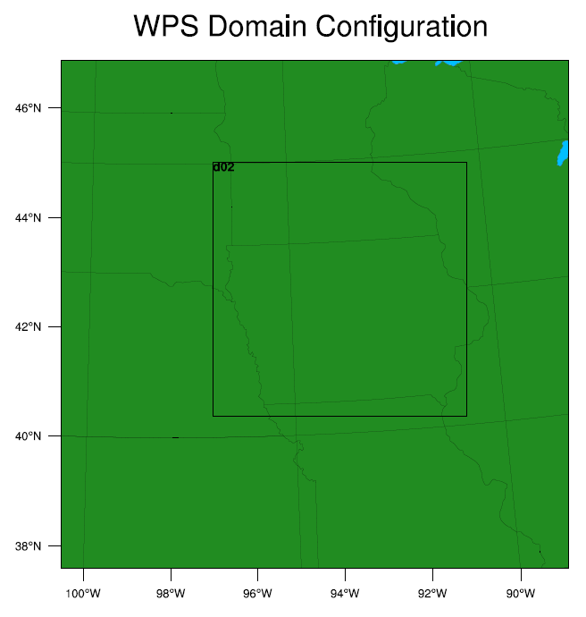
Numerical Forecast of a Ramp Event
Using the Weather Research Forecast (WRF) Model
Model set-up
  Selected a ramp event occurring over night 06/13-14/08 near Mason City, IA
  Initialized model using the North America Region Reanalysis (32-km horiz. resolution, 25mb vertical resolution) acquired from the NOAA National Climate Data Center (NCDC)
  Nested forecast domains at 10-km and 3.33km grid resolution centered of Mason City, IA
  Used MYNN PBL scheme (modified version of MYJ scheme)
  18-hr. forecasts initialized at 18Z

Slide 25
Sensitivity Tests
Range of coefficient values that have been proposed.
 | M73 | MY82 | WRF3.5 MYJ | N01 MYNN, lv3 | NN04 MYNN, lv3 | WRF3.5 MYNN
A1 | 0.78 | 0.92 | 0.660 | 1.18 | 1.18 | 1.18
B1 | 15.0 | 16.6 | 11.88 | 24.0 | 24.0 | 24.0
A2 | 0.79 | 0.74 | 0.657 | 0.665 | 0.665 | 0.665
B2 | 8.0 | 10.1 | 7.227 | 15.0 | 15.0 | 15.0
C1 | 0.056 | 0.08 | 0.00083 | 0.137 | 0.137 | 0.137
C2 | 0 | 0 | 0 | 0.65 | 0.7 | 0.729
C3 | 0 | 0 | 0 | 0.294 | 0.323 | 0.340
C4 | 0 | 0 | 0 | 0.0 | 0.0 | 0.0
C5 | 0 | 0 | 0 | 0.2 | 0.2 | 0.2
M73 (Mellor 1973) MY82 (Mellor & Yamada 1982)
N01 (Nakanishi 2001) NN04 (Nakanishi & Niino 2004)

Slide 26
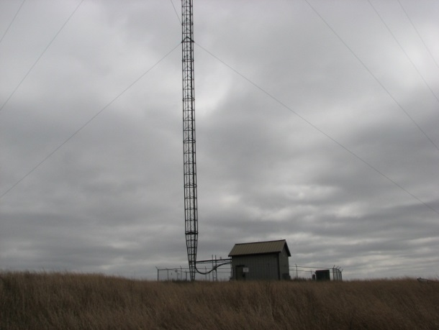
Mesoscale Numerical Forecasts of a Ramp Event
Results are compared against wind observations from tall towers in Iowa
  Data provided by Iowa Energy Center/ISU working with AWS Truepower (2007-08)
  Wind data represent 10-min. averaged wind speed and direction at heights: 50m, 100m, 150m, 200m
  Estimated range of error of anemometers is 2.8% (AWS Truepower Rpt. 2010)

Slide 27
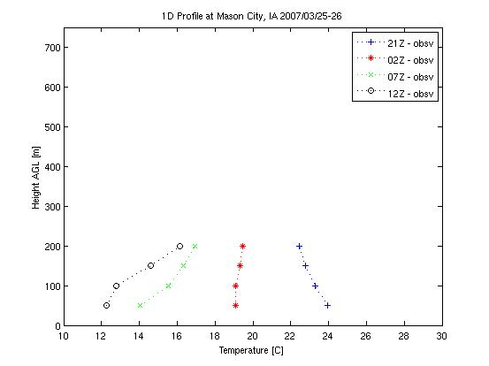
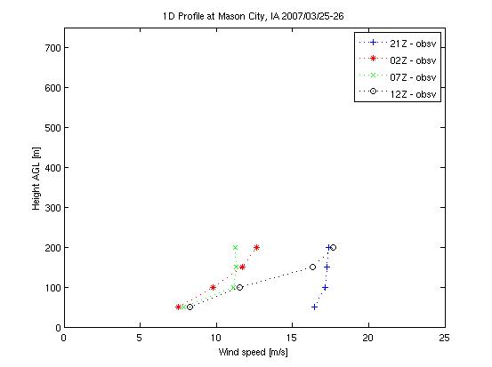
Ramp Event 03/25-26/2007
Height AGL [m]
Temperature [C]
Wind speed [m/s]
21Z blue
02Z red
07Z green
12Z black
Tall tower observations

Slide 28
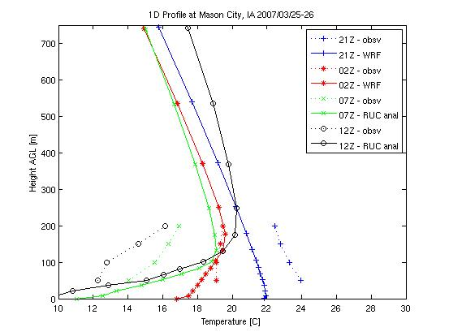
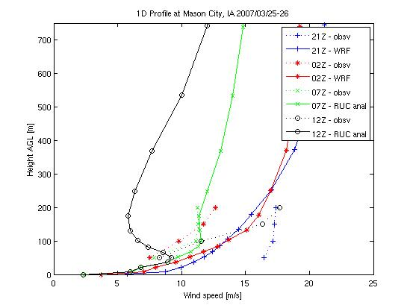
Ramp Event 03/25-26/2007
Height AGL [m]
Temperature [C]
Wind speed [m/s]
21Z blue
02Z red
07Z green
12Z black
WRF Forecast
MYNN with original coefficients (C1=0.137)

Slide 29
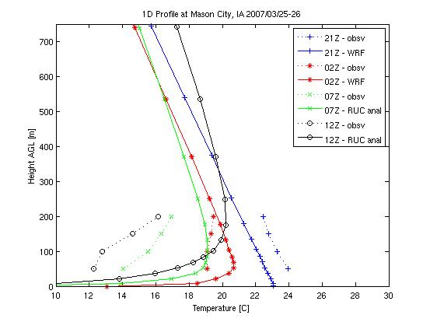
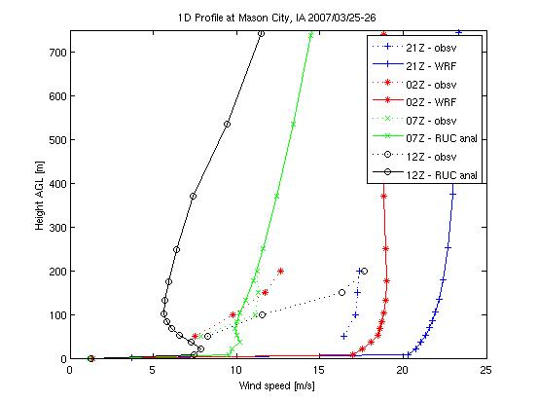
Ramp Event 03/25-26/2007
Height AGL [m]
Temperature [C]
Wind speed [m/s]
21Z blue
02Z red
07Z green
12Z black
WRF Forecast
MYNN with C1=0.2

Slide 30
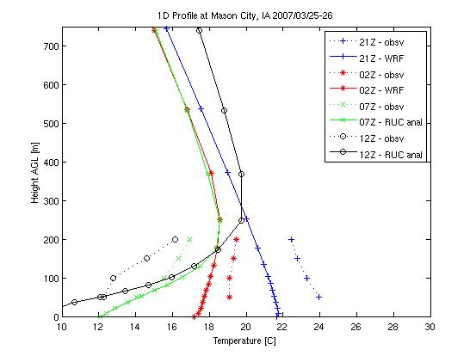
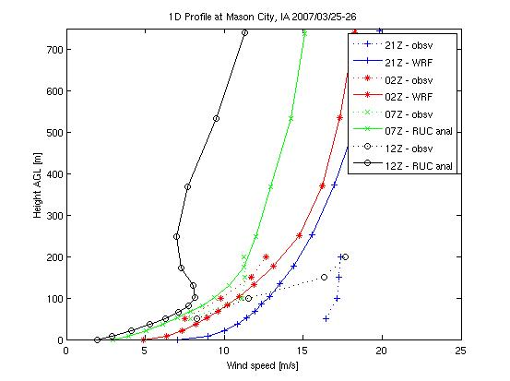
Ramp Event 03/25-26/2007
Height AGL [m]
Temperature [C]
Wind speed [m/s]
21Z blue
02Z red
07Z green
12Z black
WRF Forecast
MYNN with C1=0.05

Slide 31
Ramp Event 03/25-26/2007
MYNN with C1=0.2
Height AGL [m]
Wind speed [m/s]
MYNN original (C1=0.137)
21Z blue
02Z red
07Z green
12Z black
MYNN with C1=0.05

Slide 32
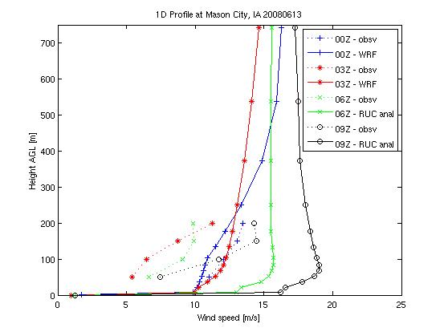
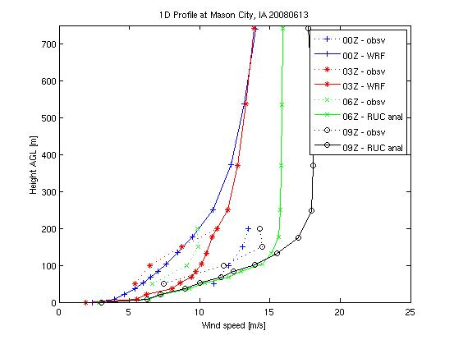
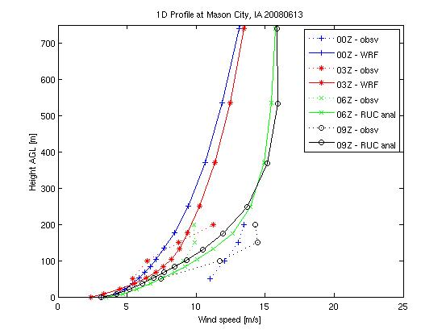
Ramp Event 06/13-14/2008
MYNN with C1=0.2
Height AGL [m]
Wind speed [m/s]
MYNN original (C1=0.137)
00Z blue
03Z red
06Z green
09Z black
MYNN with C1=0.05

Slide 33
LES Simulation of Ramp Events
Run WRF model at much higher spatial resolution O(10m) as compared to O(1km) for mesoscale runs
Explicitly resolve turbulent eddies rather than parameterize the cumulative effect of heat, moisture, and momentum turbulent fluxes
  Calculate covariance flux values directly
  Evaluate assumptions used to formulate PBL scheme for the mesoscale
Requires more computing resources:
100x100x100 = 1M factor more gridpoints than mesoscale run for same size domain

Slide 34
Summary and Future Work
The assumptions/approximations used in MYJ and MYNN schemes present basis for reconsidering the schemes for the SBL and specifically for ramp events
Preliminary results from sensitivity tests reveal significant differences in BL evolution based on coefficients associated with the energy distribution term.
  Need to evaluate other PBL coefficients
  Need to expand the set of wind ramp study cases
Use an LES model to resolve turbulence eddies and provide guidance for modifying PBL schemes for use on the mesoscale

Slide 35
References
AWS Truepower, LLC (2010). Final Report: Iowa Tall Tower Wind Assessment Project. Prepared for Iowa Energy Center, Iowa State University.
Bradford et al (WDT)
Deppe, A., G. Takle, W. Gallus, 2013. A WRF Ensemble for Improved Wind Speed Forecasts at Turbine Height. Wea. & Forecasting. 28, pp 212-228.
Ely, E., B. Kirby,, 2008. ERCOT Event on February 26, 2008: Lessons Learned. Technical Report, NREL/TP-500-43373 , National Renewable Energy Laboratory, 13 pp.
ERCOT Operations Report, 2008
Ferreira, C. et al., 2010. Report: A Survey on Wind Power Ramp Forecasting. Argonne National Laboratory, U.S. Dept. of Energy. 27 pp.
Hong, S-Y, H.-L Pan, 1996: Nonlocal boundary layer vertical diffusion in a medium-range forecast model. Mon. Wea. Rev., 124, pp. 2322-2339.

Slide 36
References
Janjic, Z.I., 1990. The step-mountain coordinate: Physical package. Mon. Wea. Rev., 118, pp. 1429-1443.
Kolmogorov, A. N., 1941. The local structure of turbulence in incompressible viscous fluid for very large Reynolds number. Dokl. Akad. Nauk SSSR, 30, p.301.
Mellor, G., 1973. Analytic prediction of the properties of stratified planetary surface layers. J. Atm. Sci., 30, pp. 1061-1069.
Mello,r G., T. Yamada, 1974. A hierarchy of turbulence closure models for planetary boundary layers. J. Atm. Sci., 13, pp. 1791-1806.
Mello,r G., T. Yamada, 1982. Development of a turbulence closure model for geophysical fluid problems. Rev. of Geophys. And Space Phys., 20, pp. 851-875.
Rotta, J.C., 1951. Statistische Theorie nichthomogener Turbulenz. Zeitschrift fur Physik. 131, p. 547-572.
Stull, R. B., 1988. An Introduction to Boundary Layer Meteorology. Kluwer Academic, 666 pp.

Slide 37
Background
Large fluctuation of wind power due to wind ramps are of concern to electric utilities especially with the continued increase in integration of wind energy as part of the electric grid
Wind ramps present the need to plan for a relatively large upswing/downswing in wind power occurring over a relatively short time (1-4 hours)
  Value for day-ahead market planning to schedule anticipated unit generation, including wind power, to meet forecast load
  Value for near real-time operations, with updated wind forecast in order to anticipate need to bring on-line slow start-up units several hours before an anticipated ramp
  Goal: maintain generation that matches load and alleviate fluctuations in power frequency
Maintaining additional generation reserve is an operational cost consideration
Response to wind ramps is over longer period of time than the nearly instantaneous response required by grid operations in the event of the failure of conventional generation units, thus there is flexibility by operators to utilize less costly resolution such as using non-spinning reserves
There is need for accurate wind forecasts at turbine height, from several hours ahead to several days ahead

Slide 38
Background: Example Impact of Wind Ramp: ERCOT Feb. 256, 2008
Significant ramp down of wind generation followed by a ramp up couple hours later
  2000MW wind power reduced to 360MW in 3.5 hrs., was forecast 1-day ahead, but 2 hours later
  3800 MW load ramp up in 1.5 hrs. to load of 35,750MW was load forecast by hour-ahead, but 25-min. later
Required an Emergency Electricity Curtailment Plan (when reserves are below 1750MW)
Some electric power purchased from Mexico (30MW)
Ramp down event caused by stabilization of the lowest atm layer after losing daytime heating after sunset (decoupled from mixing with higher-momentum air aloft)
References
Ela and Kirby 2008, ERCOT Oper. Rpt. 2008, Bradford et. Al.

Slide 39
Background: Frequency of ramp events
AWS Truewind report 2008 for ERCOT
  For system of15,000 MW wind power
    1 – 2,800MW/30min. Wind ramp per year
    2-4 – 1,300MW/30min. Wind ramp per year

Slide 40
Creating a Numerical Forecast
Select desired domain
Initialize 3D domain with values of weather variables (wind speed and direction, temperature, air moisture) at each grid point
Run the mathematical atmospheric model forward in time to achieve desired forecast horizon
Image from www.e-education.psu.edu/worldofweather

Slide 41
Causes of wind ramps
Fronts
Mesoscale models do well in identifying fronts, although timing can be an issue
Storm outflow
Storm initiation is an issue and can be of various scales (local or regional)
Strength of storm downdraft determines strength of storm outflow (related to microphysics)
Nocturnal low-level jet (LLJ)
Develops as layer just above BL is decoupled from surface friction effects and winds increase (inertial oscillation)
Ramp events can be caused by various weather situations, each with its own forecast issues.

Slide 42
Accuracy of Wind Ramp NWP Forecasts
Given that turbine-height is often in the PBL, wind ramp NWP forecasts are sensitive to the chosen PBL scheme
Study by Deppe, Gallus, Takle (2013)
  Evaluated 6 different PBL schemes
    Local mixing scheme (MYJ, MYNN)
    Non-local mixing scheme (YSU)
  General results
    Non-local mixing scheme performed best for 80m height wind forecasts
    Local mixing scheme performed best for wind ramp forecasting
Notes:
Deppe 2013: neg. bias true for all PBL schemes for 12-18 hr. fcst. horiz.
Deppe 2013: positive verif. of ramp event if event occurred within 6 hrs. of time predicted by WRF

Slide 43
Accuracy of Wind Ramp NWP Forecasts
Given that turbine-height is often in the PBL, wind ramp NWP forecasts are sensitive to the chosen PBL scheme
Study by Deppe, Gallus, Takle (2013)
  Evaluated 6 different PBL schemes
  Wind speed neg. bias 0.5-1.0 m/s for 12-18 hr. forecasts at 80m
  Number of wind ramp events underestimated
Value of improving wind forecasting by 1 m/s would result in savings of $12M over life of wind farm**
** DOE Workshop on Research Needs for Wind Resource Characterization, 14-16 Jan 2008, Broomfield, CO
Notes:
Deppe 2013: neg. bias true for all PBL schemes for 12-18 hr. fcst. horiz.
Deppe 2013: positive verif. of ramp event if event occurred within 6 hrs. of time predicted by WRF

Slide 44
MYJ PBL Scheme: Assumptions
Notes:
List approx./assumptions in table form with a column indicating appropriate or not for SBL and/or LLJ cases.

Slide 45
Ramp Event 03/25-26/2007
Mason City, IA
3/25/2007 9:30-10:30 PM 9.0-14.4 m/s
Note: get 100m WRF cross section of winds

