Slide 1
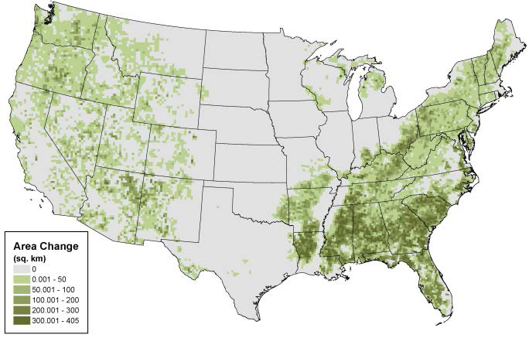
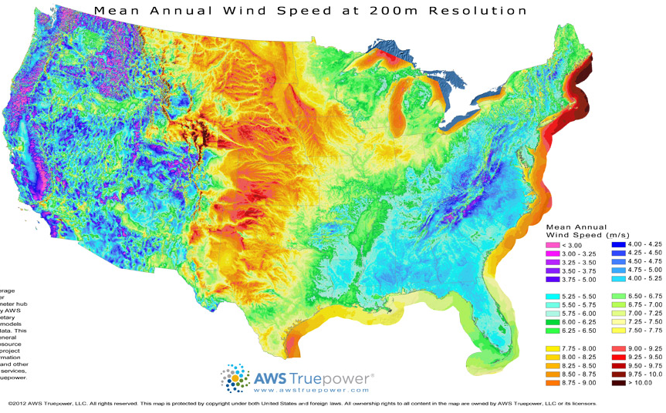
Wind Turbine Towers for Greater Hub Heights
Why higher wind turbine tower can contribute to increase energy output?
Energy output is proportional to the cube of wind velocity, 100m towers (versus 80m) would produce about 12% more power per installed turbine (NREL)
Source: NREL Report No. TP‐5000‐61063.
Source: NREL and AWS Truepower
Expanded Area of Potential Wind Energy Deployment Resulting from Increasing Hub Height from 96m to 140m
Land-based Annual Average Wind Speed at 200m Resolution

Slide 2
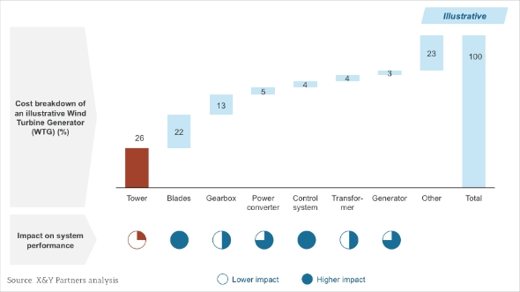
wind towers represent 26% of the total WTG (Wind Turbine Generator) cost
Notes:
A wind tower is not the first thing that comes to mind when thinking about technological developments in wind energy, as its impact on system performance is very small. However, wind towers can represent more than 25% of the total WTG (Wind Turbine Generator) cost

Slide 3
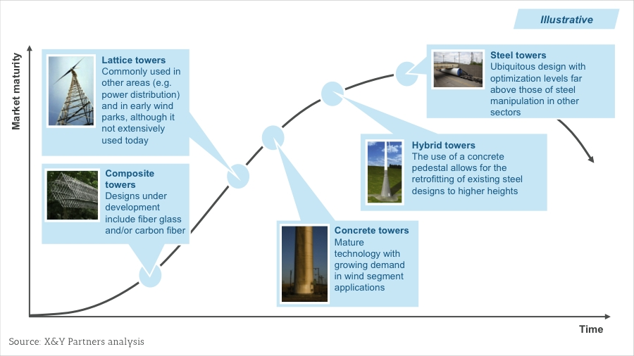
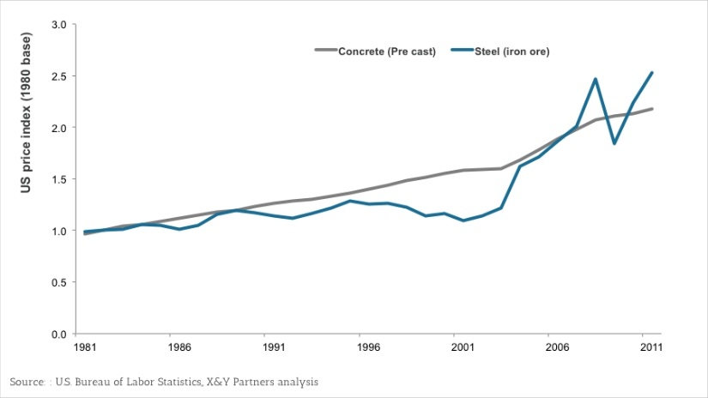
Why concrete tower is an alternative for higher wind turbine tower?
Steel towers:
Limited environmental impact
Transport as complete tubes
Speedy construction
Limitation in tower base diameter;
Deeper foundation;
More volatility in price than concrete
Notes:
A recent study [1] into carbon fibre reinforced
polymers (CFrP) showed that in view of enhanced
material properties and reduced concrete cover
requirements, the weight of a concrete wind
tower prestressed with CFrP would be about 40%
lower than that of an equivalent steel-prestressed
structure.

Slide 4
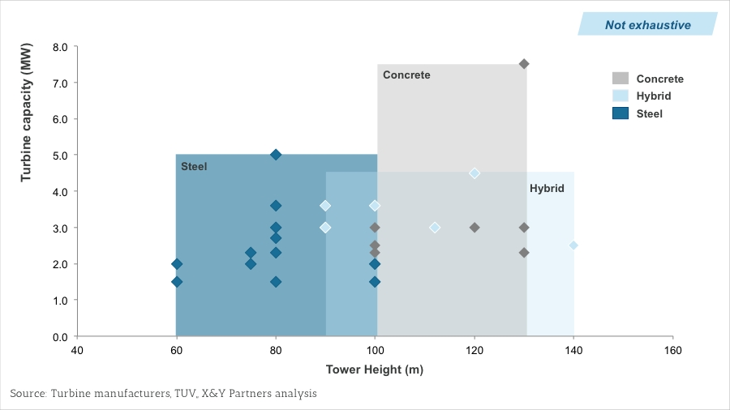
Concrete towers:
Easy transportation with small modules;
Allow for mobile factories;
Deflection (3’’-3’/300ft tower);
Increase steel’s 20 year tower life.
Two designs:
Full concrete designs
Enercon;
Acciona;
Inneo Terro;
Precast Concrete Tower Inc.
Hybrid system
Advanced Tower System;
Tindall
Sample of current offering of turbine-tower combinations

Slide 5

Acciona Windpower Concrete Tower
Prestressed concrete shells (precasted in the mobile factory and transported to site)—20m
Source: Acciona Windpower

Slide 6
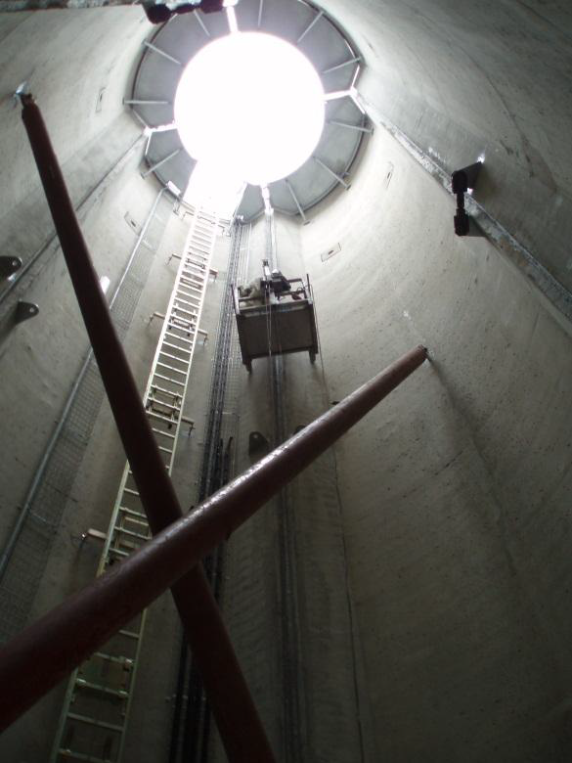
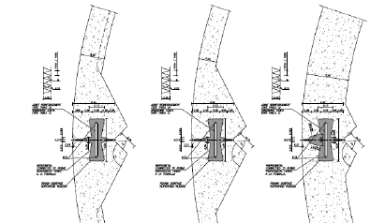
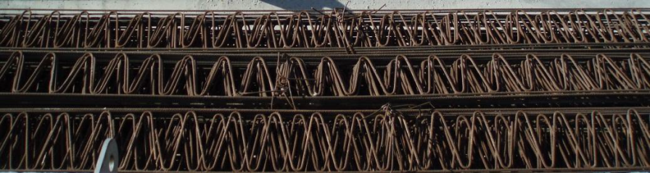
Acciona Windpower Concrete Tower
Joined through vertical patented joins on site configuring 20 meters tower sections
Source: Acciona Windpower

Slide 7

Inneo Torres
Great interior space at the base of the tower thanks to its larger diameter, which promotes the assembly of equipment within the tower on one level without space constraints.
Very easy to anchor on the walls of the tower interior elements and equipment needed.
Not conditioned by transport limitations and therefore provides freedom in the choice of the geometry of the tower
Source: Peñablanca Wind Farm, featuring a tower of 100 m
Notes:
140m

Slide 8
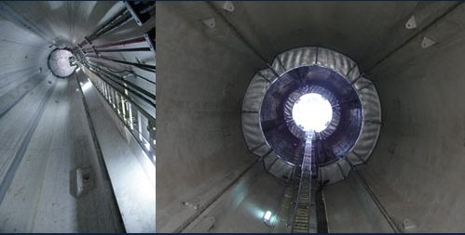
Functionality
Larger door that allows the passage of the complete equipment, which greatly facilitates installation or repair possible and, in some cases, avoids the need for additional booths for processing equipment.
Inneo Torres
Source: Peñablanca Wind Farm, featuring a tower of 100 m

Slide 9

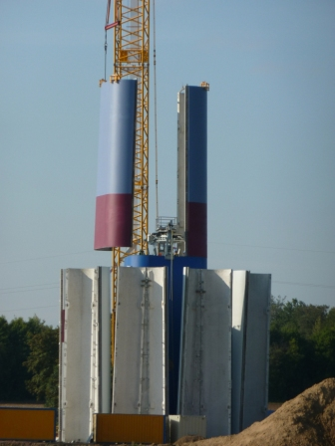
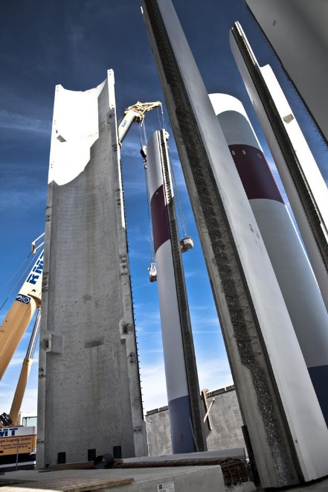
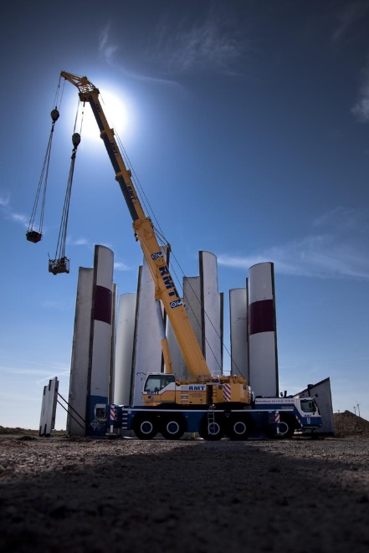
Advanced Tower System (ATS hybrid tower)
combines a pre-cast concrete segmented tower with tubular steel sections on top.
consists of three or more 15 meters long, slender segments and corner elements
Advanced Tower Systems BV

Slide 10
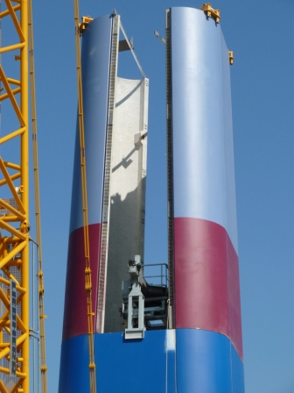
Advanced Tower System (ATS hybrid tower)
The lower tower sections, which require a diameter bigger than the 4.3m transport limit, are vertically divided into three or more slender segments made of high-quality pre-cast concrete. The segments can be easily transported via ordinary trucks.
The installation of the entire tower takes less than a week and can be done under most weather conditions.
Advanced Tower Systems BV

Slide 11

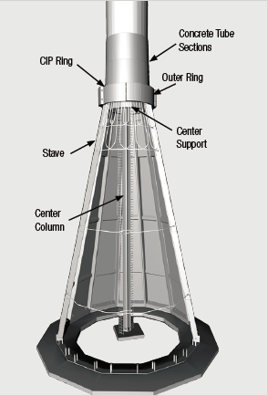
Tindall - Altas Concrete Tower Base
Accommodates 100 -140 meter class hub heights
No bolts – post-tensioned tendons only
Components can be factory manufactured or site cast
Employ prefabricated concrete rings bolted together on-site and post-tensioned using external tendons.

Slide 12
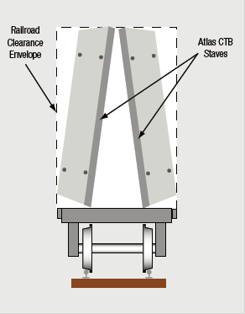
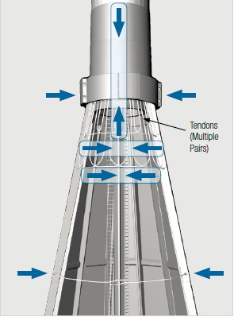
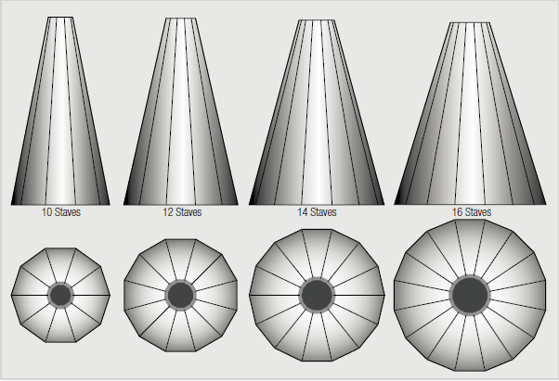
Tindall-Altas CTB
A pair of Atlas CTB staves are easily
transportable by rail within a 3-m Width x 4.5-m Height conventional rail transportation footprint.
One size stave with multiple base diameters makes easily transportable in pairs by rail;
As the number of staves increases, so does the base diameter, making this design concept able to accommodate the loads presented by higher towers and larger output turbines

Slide 13
Technique challenges in tower design
Short-term loads:
Seismic/earthquake loads: Tower may not be capable of resisting the local seismic demands.
E-stop: The short/hard stop creates a shock load spectrum on the structure and results in a drastic dynamic impulse load to the system, resulting in large lateral deflections.
Long-term sustained loads:
The most unique aspect of wind tower structural design is the dynamic characteristics and fatigue-elated issues. Long-term loads are the normal operational wind loads that include dead, live, static wind pressure and standard operational overturning moments, shears and axial loads. The frequency of these long-term sustained loads may reach over 20,000,000 cycles in 20 years. Therefore, every aspect of the tower-foundation design must consider these provisions.
Notes:
Of all civil engineered structures, the wind tower stands as an inherently special structure because it is a "working machine" with moving parts, versus a bridge or high rise building. These inherent dynamic loads create many issues that are not normally considered in static structures.

Slide 14
Questions
Thank you !

