Slide 1
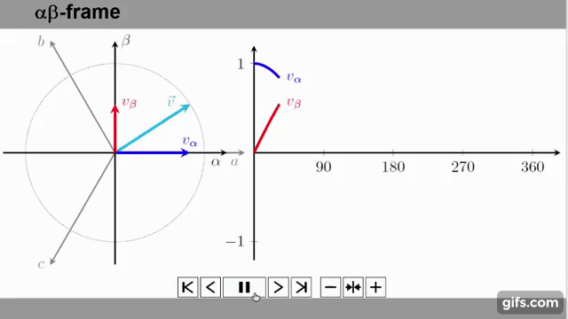
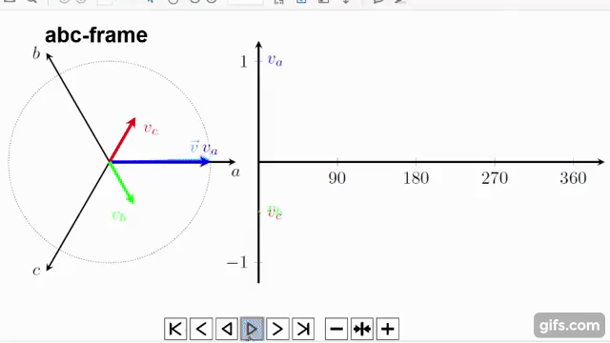
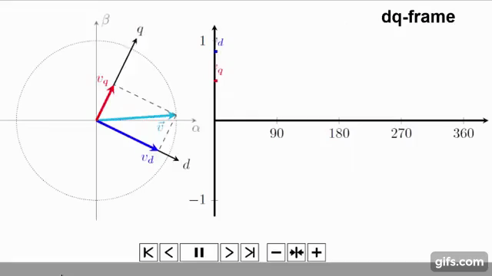
Comparison of abc to d-q (Park) and α-β (Clarke) transformation.
[24] https://www.youtube.com/watch?v=vdeVVTltr1M

