Slide 1
Class 1
Economic systems for electric power planning
Introduction
Professor James McCalley

Slide 2
We will use our own course webpage, found at
home.eng.iastate.edu/~jdm/ee458/ee458schedule.htm
You will find the course schedule at the above location.
You should bookmark the above location because you will be referring to it often during the course.
Also notice the tabs for “Objectives” and
“Course structure”.

Slide 3
Assignments for this week
Read notes called “Overview of Electricity Markets.” Review ppt called “EE458Intro” including appendix.
Read “Notes on cost curves.”
Read Paper linked by the name of “California Crisis Explained.” Complete HW1 to turn in on Tuesday 9/3.

Slide 4
What this course is about
The electric industry and ….
Its characteristics before,
but mainly its characteristics after
Before, and after what?

Slide 5
What happened?
Deregulation
Privatization
Vertical disaggregation
Functional unbundling
Introduced markets
Brought competition

Slide 6
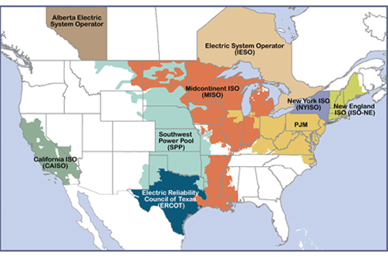
When did this happen?
2019 N. AMERICAN
ELECTRICITY MARKETS
Well, sort of, actually, it all started much earlier…

Slide 7
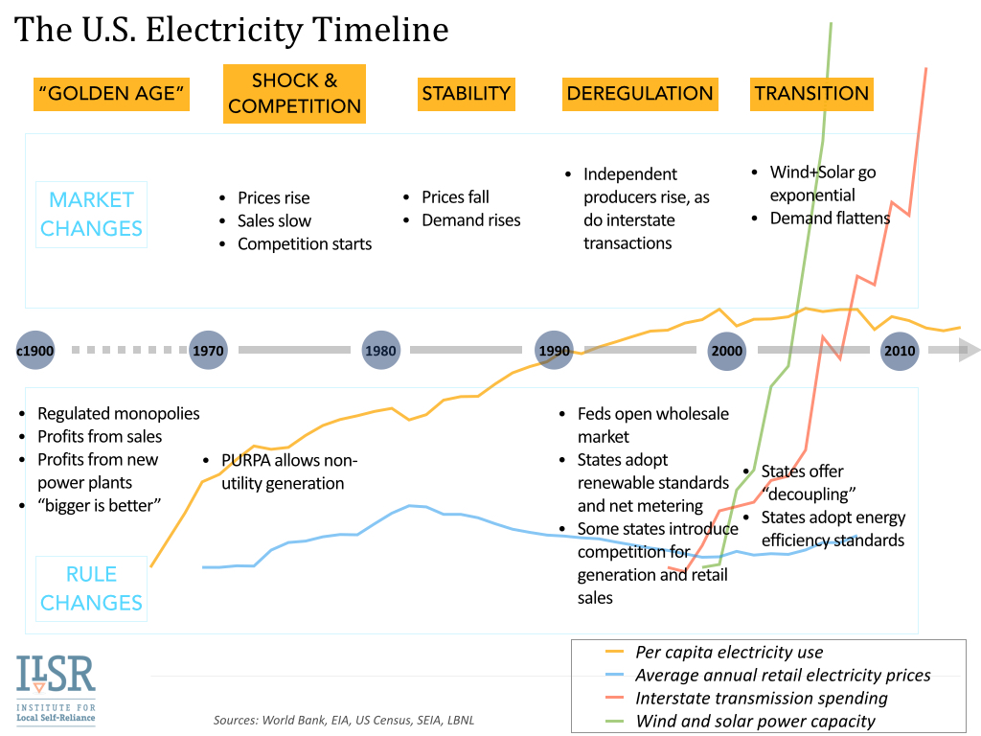
See appendix for more detail on the evolution of the electric industry.

Slide 8
What was it before ~1996?
A monopolistic, and regulated, industry
In any given region, there is only one organization from which to buy.
Other organizations are blocked.
Reasons for giving monopoly status can vary, but in the electric industry, the main reason was…
Economies of scale…
when average cost of production, $/MWhr, decreases as generation plant gets larger.

Slide 9
Economies of scale
$40/MWhr
$50/MWhr
1000 MW Plant
Four 250 MW Plants
And this drove all thinking in the electric industry from 1900 until the early 1960’s.
And then what happened?

Slide 10
Four things
Concerns over gold-plating (Averch-Johnson, A-J, 1962)
If utilities are monopolies, then they cannot be allowed to set their own rates. Therefore, utilities are regulated by public utility commissions (PUCs).
[In Iowa, it is called the “Iowa Utility Board” (IUB).]
This means PUCs set the level of profit that a utility can make. To do this, PUCs determine the total revenue requirement for the utility, computed based on:
Total Revenue Requirement =
Rate Base ×Allowed Rate of Return
+Expenses
Aside: “Expenses”- fixed+variable costs; utility must recover both, but EE programs reduce expenses & is therefore discencentized away from EE, giving rise to “decoupling” (see slide 7)
The “Allowed Rate of Return” (AROR) is what the utility can provide to shareholders.
Utilities present “rate cases” to their PUCs and try to maximize their AROR.
The “Rate Base” is the value of the utility’s assets minus accumulated depreciation.
A-J recognized a “sneak-attack” that some utilities used: build more assets, or bigger assets (arguing for economies of scale), even when they were not so much needed.

Slide 11
Four things
Contrary to economy of scales, smaller plants began to look more economic (and so anyone almost could build one). Why ?
  Large plants take years to build, often must be located far away, and can have severe impact when they outage. Smaller plants
    are built more quickly and their construction costs are consequently subject to less economic uncertainty;
    can be located more closely to load centers, an attribute that avoids transmission, decreases system losses, & is advantageous for system security;
    are generally more reliable, and less consequential when they do outage.
  Combined cycle units, attractive because of high efficiency, have to account for design complexities due to coupling between CTs & HRSGs driven by waste heat from the CTs, and so tend to be lower in rating.
  Cogeneration facilities, attractive because of high efficiency, typically have lower ratings as a result of their interdependency with the industrial steam processes supported by them.
  Plants fueled by renewable energy sources (biomass, wind, solar, and independent hydro), attractive because of their low operating expenses and environmental appeal, also tend to have lower ratings.

Slide 12
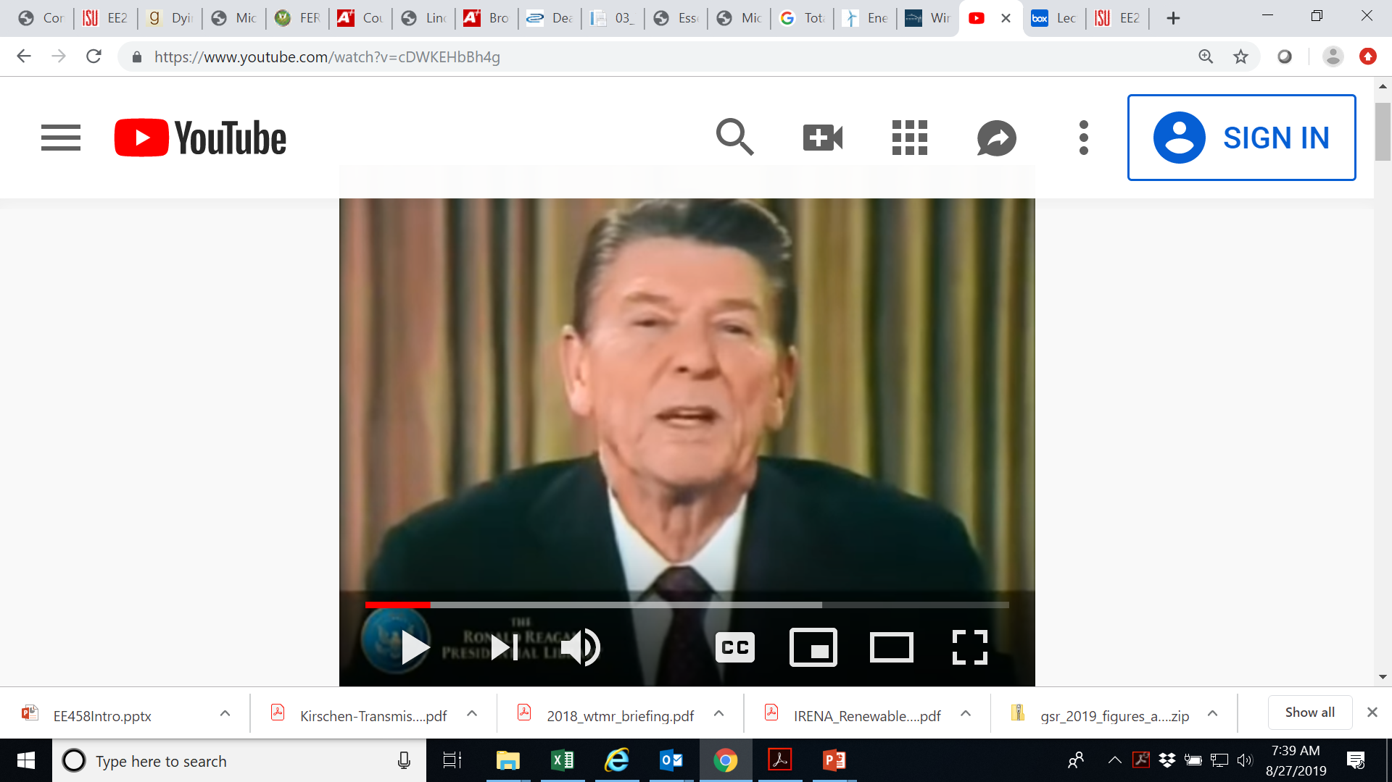
Four things
Reaganomics – and public approval of less tax, less government, less regulation, more competition (lower prices).
Ronald Reagan, 40th president, elected 1980, gave this speech to the nation on February 5, 1981.
Listen for the word “regulation.” Listen for economic words. And listen, towards the end, for emphasis on “unleashing.”

Slide 13
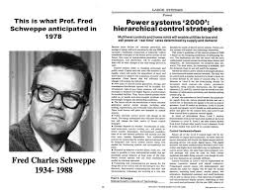
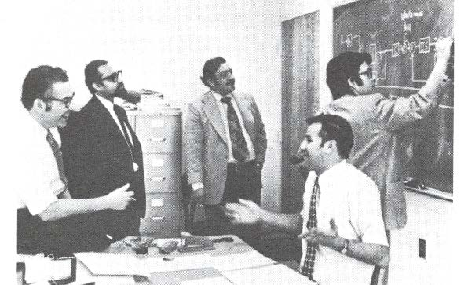
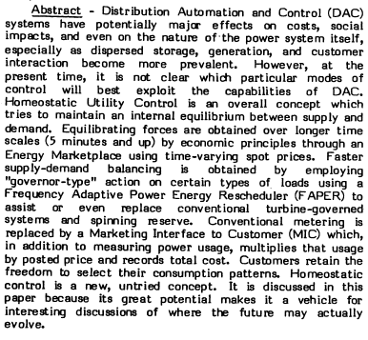
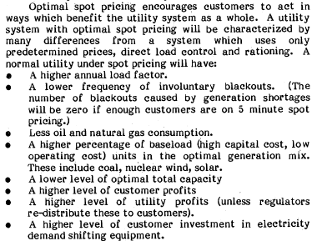
Four things
Homeostasis: the tendency of a system to maintain internal stability, owing to the coordinated response of its parts to any situation or stimulus that would tend to disturb its normal condition or function.
Fred Schweppe:
  F. Schweppe, “Power Systems 2000,” IEEE Spectrum, Vol. 15, No. 7, July 1978.
  F. Schweppe, R. Tabors, J. Kirtley, H. Outhred, F. Pickel, and A. Cox, “Homeostatic Utility Control,” IEEE Trans. Pwr. App. And Sys., Vol. PAS-99, No. 3, May/June 1980.
  M. Caramanis, R. Bohn, and F. Schweppe, Optimal spot pricing: practice & theory, IEEE Transactions on Power Apparatus and Systems, Vol. PAS-101, No. 9 September 1982.
  F. Schweppe, M. Caramanis, R. Tabors, R. Bohn, “Spot Pricing of Electricity,” Kluwer, 1988.

Slide 14
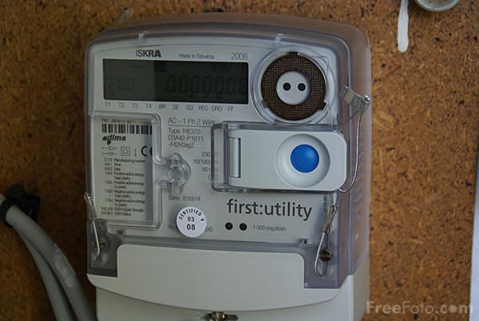
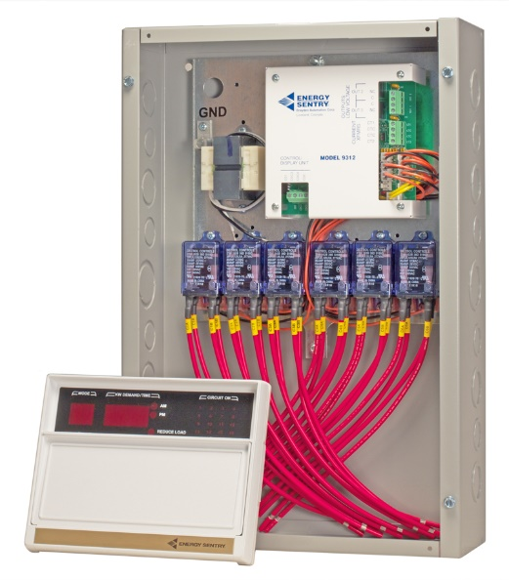
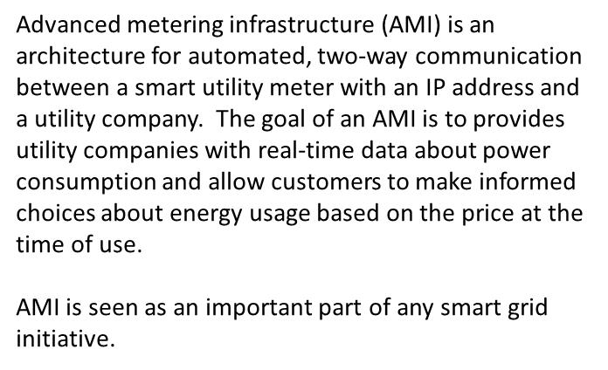
And Fred was right-on! This is what it looks like today…
Advanced Metering Infrastructure
Residential Demand Controller
27-Aug-2019 - 8:50 CT
25-Aug-2019 - 19:55 CT
MISO Real-Time
Locational Marginal Prices
www.misoenergy.org/markets-and-operations/real-time--market-data/real-time-displays/

Slide 15
Given that the industry was monopolistic
and is now competitive, what change must have occurred organizationally?
Vertical disaggregation
(functional unbundling)

Slide 16
Transmission and
System Operator
G
G
G
G
G
G
G
G
Vertically Integrated Utility
1900-199?

Slide 17
Transmission and
System Operator
G
G
G
Transmission
Owner
G
G
G
G
G
G
Transmission
Owner
G
G
G
Independent
System
Operator
G
G
Transmission
Owner
Vertically Integrated Utility
1900-199?
G
G
Today

Slide 18
And the ISOs runs the electricity markets
None of them existed in their present form previous to ~1996.
They own no generation or transmission.
They are central to the three most important power system functions today:
➔market operations, grid operations, and grid planning.

Slide 19
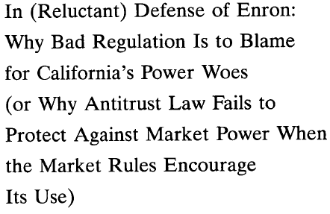
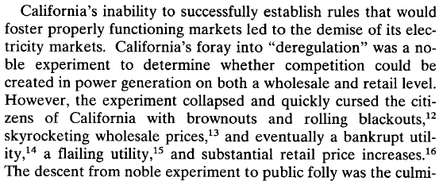
This was not without its ups and downs ☹
HW1…

Slide 20
Which leads to the course objectives
Objective 1: Identify the basic microeconomic principles on which electricity markets are based.
Objective 2: Articulate the basic principle of the simplex method for solving linear programs.
Objective 3: Formulate and solve a linear program using Matlab, Excel, or CPLEX.
Objective 4: Articulate principles of branch & bound algorithm for solving integer programs
Objective 5: Formulate and solve an integer program using Matlab, Excel, or CPLEX.
Objective 6: Identify the main design attributes of an electricity market system.
Objective 7: Set up and solve for the social optimum and locational marginal prices of a network
with agents having elastic supply and demand functions, using linear programming.
Objective 8: Identify how security constrained economic dispatch and the security constrained
unit commitment are used in electricity markets.
Objective 9: Identify motivation for & approach used in markets for financial transmission rights.
Objective 10: Identify the motivation for and approach used in markets for resource capacity.
ELECTRICITY MARKETS
MICROECONOMICS
OPTIMIZATION
POWER SYSTEM ENGR

Slide 21
A question
Are electricity markets new?
A commodity market is a market where agents trade (buy and sell) primary products such as wheat, coffee, cocoa and sugar; and gold, rubber and oil.
Commodity markets in a crude early form are believed to have originated in Sumer (Iraq) between 4500 BC and 4000 BC. Sumerians first used clay tokens sealed in a clay vessel, then clay writing tablets to represent the amount—for example, the number of goats, to be delivered. These promises of time and date of delivery resemble futures contract.
In 1864, in the United States, wheat, corn, cattle, and pigs were widely traded using standard instruments began trading on the Chicago Board of Trade (CBOT), the world's oldest futures and options exchange. Other food commodities were added to the Commodity Exchange Act and traded through CBOT in the 1930s and 1940s, expanding the list from grains to include rice, mill feeds, butter, eggs, Irish potatoes and soybeans.
http://en.wikipedia.org/wiki/Commodity_market

Slide 22
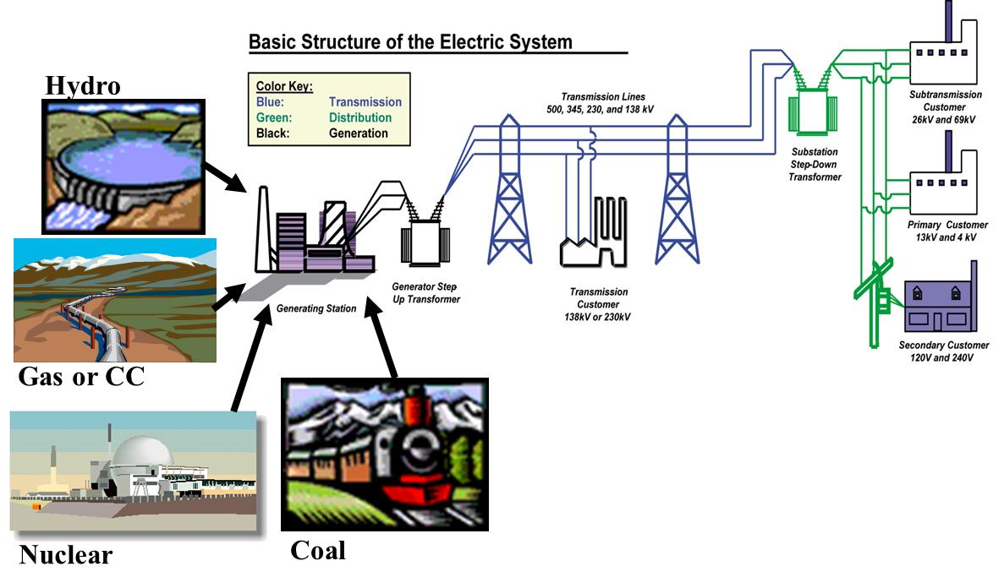
An answer
NO, economic systems for trading have existed for millenia …
Sellers submit offers to sell in terms of
Price ($/MWhr)
Quantity (MWhr)
Internet System
B1
Buyers submit bids to buy in terms of
Price ($/MWhr)
Quantity (MWhr)
S1
B2
S2
B3
But not on top of a very delicate machine that can break, creating havoc in society when it does

Slide 23
APPENDIX
Evolution of Electric Industry

Slide 24
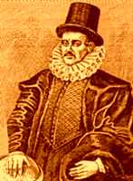
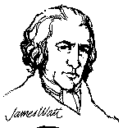
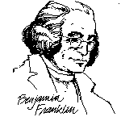
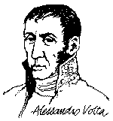
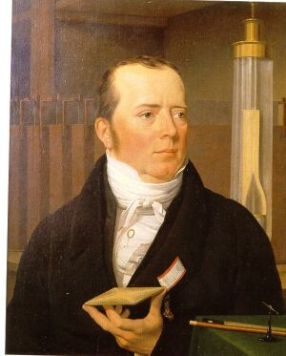
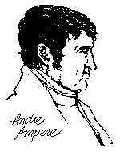
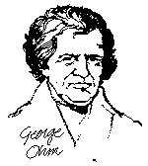
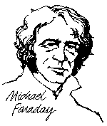


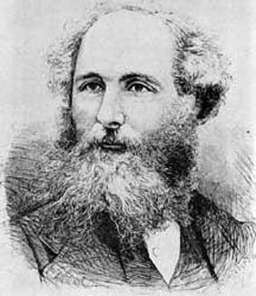
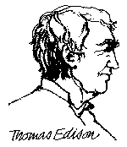
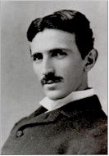
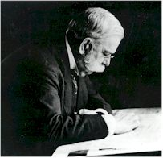


Evolution of Electric Industry
1736: James Watt invents steam engine.
1752: Ben Franklin proves lightning is electricity
1792: Alessandro Volta invented the battery.
1820: Hans Oerstead discovered magnetic effects of a current on a compass needle.
1820:Marie Ampere discovered a coil of wire acts like a magnet when carrying current.
1827: George Ohm discovered the relation between voltage, current, and resistance.
1600: William Gilbert invents the compass.
1732: Stephen Gray discovers conduction..
1745 Musschenbroek invents Leyden jar (capacitor)
1785: Charles Coulomb discovers relation between force and charge.
1827: Joseph Henry discovered inductance.
1831: Michael Faraday discovered Faraday’s law and invented the generator
1845: Gustav Kirchoff developed laws enabling the efficient calculation of currents in complex circuits.
1855: Wilhem Weber defined units for current and resistance.
1873: James Maxwell wrote equations describing electro-magnetic fields, and predicted the existence of electromagnetic waves.
1879: Edison invented the incandescent lamp and in 1882 supplied Pearl St (NY) with light from DC generator.
1888: Nikolai Tesla patented the AC polyphase motor.
1888: H. Hertz experimentally verified Maxwell’s equations
1895: George Westinghouse harnessed Niagara Falls and commercialized AC generation, transformation, and transmission.
1835: Johann Gauss related magnetic flux & electric charge.
1886: William Stanley invented the transformer.
Notes:
Gilbert and Gray were English.
Musschenbroek was Dutch.
Watt is the unit of power. Watt was Scottish.
Coulomb is the unit of electric charge. He was French.
Volt is the unit of electric potential or voltage. Volta was Italian.
Oerstead was a Danish man, and the unit of magnetic field intensity H is named for him (1 Oerstead-1Ampere/meter)
Ampere had learned Latin in less than 2 weeks at the age of 14. Ampere is the unit of electric current. He was French.
Ohm is the unit of resistance. He was German.
Farad is the unit of capacitance. He was English.
Gauss is the unit of magnetic flux density B. He was German.
Weber is the unit of magnetic flux phi. He was German.
Maxwell is also the unit of magnetic flux phi=1E-8 Weber. Maxwell was Scottish.
Tesla is also the unit of magnetic flux density B=1E4 Gauss. He was Serbian.
Hertz is the unit of frequency. He was German.
Edison, Westinghouse, and Stanley were American.
In the 1880's, two developments concurred to set the stage for the invention of the electric chair. In 1886, the New York State Government established a legislative commission to study humane forms of capitol punishment. At that time hanging was the number one method of carrying out the death penalty, even while considered too slow and painful a method of execution.
The second development was a growing rivalry between the two giants of the young electrical utility industry. Thomas Edison was the first person to establish himself in the industry with DC service. Westinghouse, developers of the newer AC technology, challenged Edison's dominance of the utility industry. At the same time, copper prices were beginning to rise and DC depended on thick copper electrical cables. Rising copper prices made the DC service more costly and DC had other disadvantages, it could not provide services beyond a few miles of each generator.
Edison reacted to the competition by starting a smear campaign against Westinghouse, claiming AC technology was unsafe to use. In 1887, Edison held a public demonstration in West Orange, New Jersey, supporting his accusations. Edison set up a 1,000 volt Westinghouse AC generator attached to a metal plate and executed a dozen innocent animals. The press had a field day describing the event and the new term " electrocution " was used to describe execution by electricity.
On June 4, 1888, the New York Legislature passed a law establishing electrocution as the state's method of execution, but since two potential designs (AC and DC) of the electric chair existed, it was left to a committee to decide which form was better. Edison actively campaigned for the selection of the Westinghouse chair, expecting that the consumer would not want the same type of electrical service in their homes.
Later in 1888, the Edison research facility hired inventor Harold P. Brown. Brown had recently written a letter to the New York Post describing a fatal accident where a young boy died after touching an exposed telegraph wire running on AC current. Brown and his assistant Dr. Fred Peterson began designing an electric chair for Edison. They conducted cruel experiments using dogs, horses and cows to research AC electro-cution, publicly experimenting with DC voltage to show that it left the poor lab animals tortured but not dead, then testing AC voltage to demonstrate how AC killed swiftly.
The press always invited to watch these experiments gave the research much publicity. Dr. Peterson steered the government committee that had to select the best electro-cution method. Peterson was still on the payroll of the Edison Company, so it was not surprising when the committee soon announced that the electric chair with AC voltage was chosen for the State's prison system.
On January 1, 1889, the world's first electrical execution law went into full effect. Westinghouse protested and refused to sell any AC generators directly to the New York State prison authorities. Edison and Brown found a way around Westinghouse and provided the AC generators needed for the first working electric chairs. Westinghouse funded the appeals for those first few souls sentenced to death by electrocution, the appeals were made on the grounds that "electrocution was cruel and unusual punishment." Edison and Brown both testified for the state that execution was a quick and painless form of death. The State of New York won the appeals. For many years people referred to the process of being electrocuted in the chair as being "Westinghoused".
Edison's plan to bring on the demise of Westinghouse did not work, on the contrary it soon became clear that the AC technology was vastly superior to DC technology. Edison finally admitted years later - that he had thought so himself all along.

Slide 25
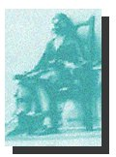
Evolution of Electric Industry
“Westinghoused”
1827: George Ohm discovered the relation between voltage, current, and resistance.
1600: William Gilbert invents the compass.
1732: Stephen Gray discovers conduction..
1736: James Watt invents steam engine.
1752: Ben Franklin proves lightning is electricity
1792: Alessandro Volta invented the battery.
1820: Hans Oerstead discovered magnetic effects of a current on a compass needle.
1820:Marie Ampere discovered a coil of wire acts like a magnet when carrying current.
1745 Musschenbroek invents Leyden jar (capacitor)
1785: Charles Coulomb discovers relation between force and charge.
1827: Joseph Henry discovered inductance.
1831: Michael Faraday discovered Faraday’s law and invented the generator
1845: Gustav Kirchoff developed laws enabling the efficient calculation of currents in complex circuits.
1855: Wilhem Weber defined units for current and resistance.
1873: James Maxwell wrote equations describing electro-magnetic fields, and predicted the existence of electromagnetic waves.
1879: Edison invented the incandescent lamp and in 1882 supplied Pearl St (NY) with light from DC generator.
1888: Nikolai Tesla patented the AC polyphase motor.
1888: H. Hertz experimentally verified Maxwell’s equations
1895: George Westinghouse harnessed Niagara Falls and commercialized AC generation, transformation, and transmission.
1835: Johann Gauss related magnetic flux & electric charge.
1886: William Stanley invented the transformer.
Notes:
Gilbert and Gray were English.
Musschenbroek was Dutch.
Watt is the unit of power. Watt was Scottish.
Coulomb is the unit of electric charge. He was French.
Volt is the unit of electric potential or voltage. Volta was Italian.
Oerstead was a Danish man, and the unit of magnetic field intensity H is named for him (1 Oerstead-1Ampere/meter)
Ampere had learned Latin in less than 2 weeks at the age of 14. Ampere is the unit of electric current. He was French.
Ohm is the unit of resistance. He was German.
Farad is the unit of capacitance. He was English.
Gauss is the unit of magnetic flux density B. He was German.
Weber is the unit of magnetic flux phi. He was German.
Maxwell is also the unit of magnetic flux phi=1E-8 Weber. Maxwell was Scottish.
Tesla is also the unit of magnetic flux density B=1E4 Gauss. He was Serbian.
Hertz is the unit of frequency. He was German.
Edison, Westinghouse, and Stanley were American.
In the 1880's, two developments concurred to set the stage for the invention of the electric chair. In 1886, the New York State Government established a legislative commission to study humane forms of capitol punishment. At that time hanging was the number one method of carrying out the death penalty, even while considered too slow and painful a method of execution.
The second development was a growing rivalry between the two giants of the young electrical utility industry. Thomas Edison was the first person to establish himself in the industry with DC service. Westinghouse, developers of the newer AC technology, challenged Edison's dominance of the utility industry. At the same time, copper prices were beginning to rise and DC depended on thick copper electrical cables. Rising copper prices made the DC service more costly and DC had other disadvantages, it could not provide services beyond a few miles of each generator.
Edison reacted to the competition by starting a smear campaign against Westinghouse, claiming AC technology was unsafe to use. In 1887, Edison held a public demonstration in West Orange, New Jersey, supporting his accusations. Edison set up a 1,000 volt Westinghouse AC generator attached to a metal plate and executed a dozen innocent animals. The press had a field day describing the event and the new term " electrocution " was used to describe execution by electricity.
On June 4, 1888, the New York Legislature passed a law establishing electrocution as the state's method of execution, but since two potential designs (AC and DC) of the electric chair existed, it was left to a committee to decide which form was better. Edison actively campaigned for the selection of the Westinghouse chair, expecting that the consumer would not want the same type of electrical service in their homes.
Later in 1888, the Edison research facility hired inventor Harold P. Brown. Brown had recently written a letter to the New York Post describing a fatal accident where a young boy died after touching an exposed telegraph wire running on AC current. Brown and his assistant Dr. Fred Peterson began designing an electric chair for Edison. They conducted cruel experiments using dogs, horses and cows to research AC electro-cution, publicly experimenting with DC voltage to show that it left the poor lab animals tortured but not dead, then testing AC voltage to demonstrate how AC killed swiftly.
The press always invited to watch these experiments gave the research much publicity. Dr. Peterson steered the government committee that had to select the best electro-cution method. Peterson was still on the payroll of the Edison Company, so it was not surprising when the committee soon announced that the electric chair with AC voltage was chosen for the State's prison system.
On January 1, 1889, the world's first electrical execution law went into full effect. Westinghouse protested and refused to sell any AC generators directly to the New York State prison authorities. Edison and Brown found a way around Westinghouse and provided the AC generators needed for the first working electric chairs. Westinghouse funded the appeals for those first few souls sentenced to death by electrocution, the appeals were made on the grounds that "electrocution was cruel and unusual punishment." Edison and Brown both testified for the state that execution was a quick and painless form of death. The State of New York won the appeals. For many years people referred to the process of being electrocuted in the chair as being "Westinghoused".
Edison's plan to bring on the demise of Westinghouse did not work, on the contrary it soon became clear that the AC technology was vastly superior to DC technology. Edison finally admitted years later - that he had thought so himself all along

Slide 26
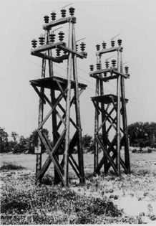
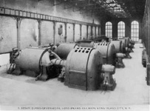
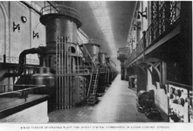
Evolution of Electric Industry
1903 Samuel Insull understanding economies of scale (generators when scaled up produce power at a lower $/kWhr – big is better!) installs 5 MW generator in Chicago and manages load to increase his load factor (avg load/max load) to increase profits
1907 Insull realizes that profitability from managing economies of scale and load factor grows with corporate size, and so forms Commonwealth Edison, Chicago, by buying all of his competitors.
1907 States begin recognizing electric companies as natural monopolies similar to the railroads, with large economies of scale requiring huge capital investment so that it was not socially efficient to have multiple competitors
Transmission switches
on wooden towers, 1906
Steam turbo-generators,
Long Island railways, c.1907
Fiske Street Station steam turbine
Chicago, c.1907

Slide 27
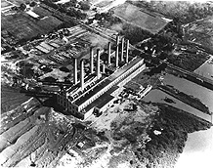
Evolution of Electric Industry
1914 About 43 states had established government oversight (state regulation) of electric utilities, requiring reliability and the obligation to serve from utilities, and giving right to recover reasonable return from the rate base on their investments, contributing to perspective that utility stocks were good for retirement.
1920, Congress established the Federal Power Commission (FPC) to coordinate hydroelectric projects under federal control.
1927 In US, 75,400 MWhr sold, from 5700 MWhr in 1907
Equipment manufacturers (GE) started holding companies that would buy and manage many operating companies, offering them equipment and services that they could not afford themselves, & establishing interconnections between them.
Potomac Electric Power Co.
power station near Washington DC, 1939

Slide 28
Evolution of Electric Industry
1927 There were 4400 operating companies, 180 holding companies; top holding companies in pyramids often overcharged subsidiary (operating) companies.
1929 Stock market crash caused loss among holding companies; a few survived
1932 Only 8 holding companies owned 75% of the operating companies, & they were exempt from state regulation since their business crossed state boundaries.
1932 FDR elected on promise to reform the industry of “the Ishmaels and the Insulls, whose hand is against everyman's.”
1935 Investor-owned utilities (IOUs) resisted supplying rural areas on grounds it would not be profitable. So US Rural Electrification Administration created to facilitate creation of municipals and co-operatives in rural areas.
1935 Public Utility Holdings Company Act (PUCHA)
  Broke up layered interstate holding companies; allowed 1 level above operating company; required them to divest holdings that were not within a single circumscribed geographical area; reduced existing monopoly power.
  Required companies to engage only in business essential for the operation of a single integrated utility, and eliminated non-utility generators (NUGs-didn’t want companies moving into other areas); reduced future monopoly power.
  Required companies to register with Security & Exchange Commission (SEC)

Slide 29
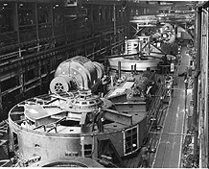
Evolution of Electric Industry
1938-1964: Golden years!
  Holding companies declined from 216 to 18.
  Generator max plant efficiencies increased from ~20% to ~40%.
  Generation max size increased from ~110 MW to ~1000 MW.
  Transmission typical voltage increased from mostly 60 kV to 230, 345, and 500 kV.
  Load grew at ~8%/year, doubling every 10 years.
  Price declined at 50 cents/kWhr to 10 cents/kWhr.
  Grow and build!
1964 About 77% electric energy from IOUs and 23% from municipals, co-ops, and government (e.g., WAPA, BPA, TVA).
45,000 Kilovolt-ampere waterwheel
for Tennessee Valley Authority
(foreground), c.1938

Slide 30
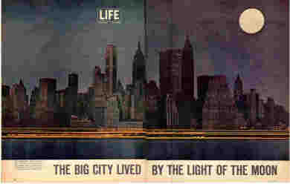
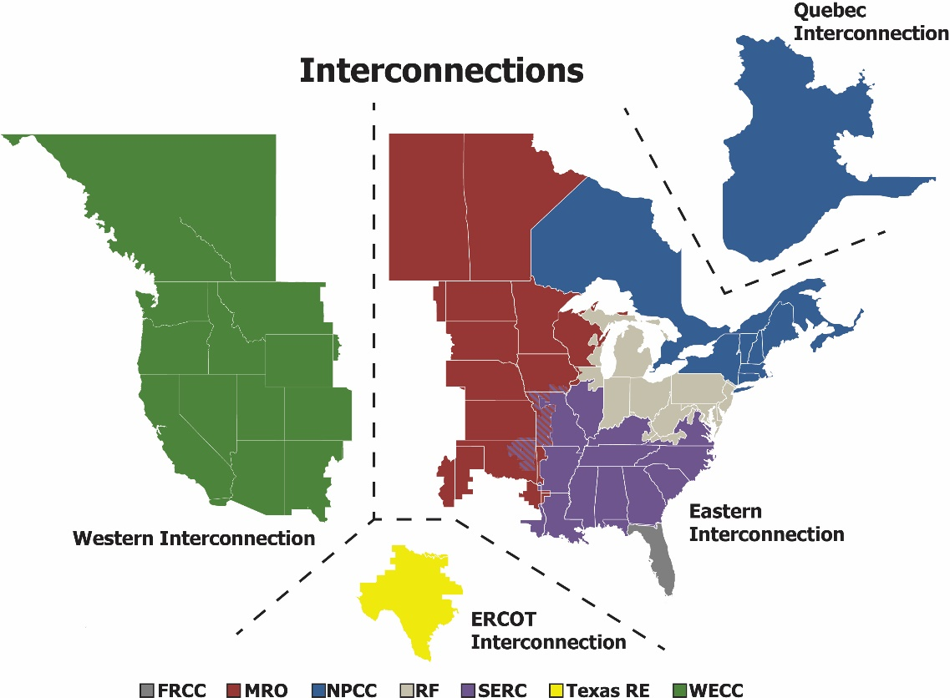
Evolution of Electric Industry
1965, 5:27 pm, Nov 9: Northeast Blackout, 20000 MW lost, 80,000 people interrupted in northeast US, including NYC.
1968 North American Electric Reliability Corporation (NERC) created.

Slide 31
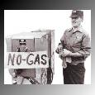
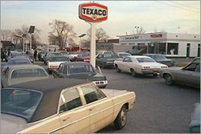
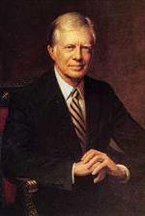

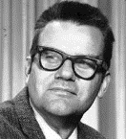
Evolution of Electric Industry
1970 Technical limits to economies of scale and to plant efficiencies, aversion to coal due to cheap petroleum and nuclear, & OPEC.
1973 Energy Crisis
1977 Department of Energy (DOE) created
to address US policies regarding energy and safety in handling nuclear material
1977, FPC changed to FERC (regulates transmission and wholesale markets for interstate commerce). .
“the moral
equivalent
of war.”
Schweppe initially called it “homeostatic control,” The word homeostasis combines forms of homeo, "similar," and stasis, "standing still," yielding "staying the same."
1978, Airline industry deregulated
1978 Public Utility Regulatory Policies Act (PURPA): utilities had to interconnect, buy, at avoided cost from qualifying facilities (small power producers using 75% renewables or cogeneration).
1978: Fred Schweppe at MIT proposed “spot pricing” of electricity
1979 Three-mile island accident.
1980 Reaganomics
1987 Non-utility generation grows ➔
MAJOR QUESTION: Are electric utilities natural monopolies?

Slide 32
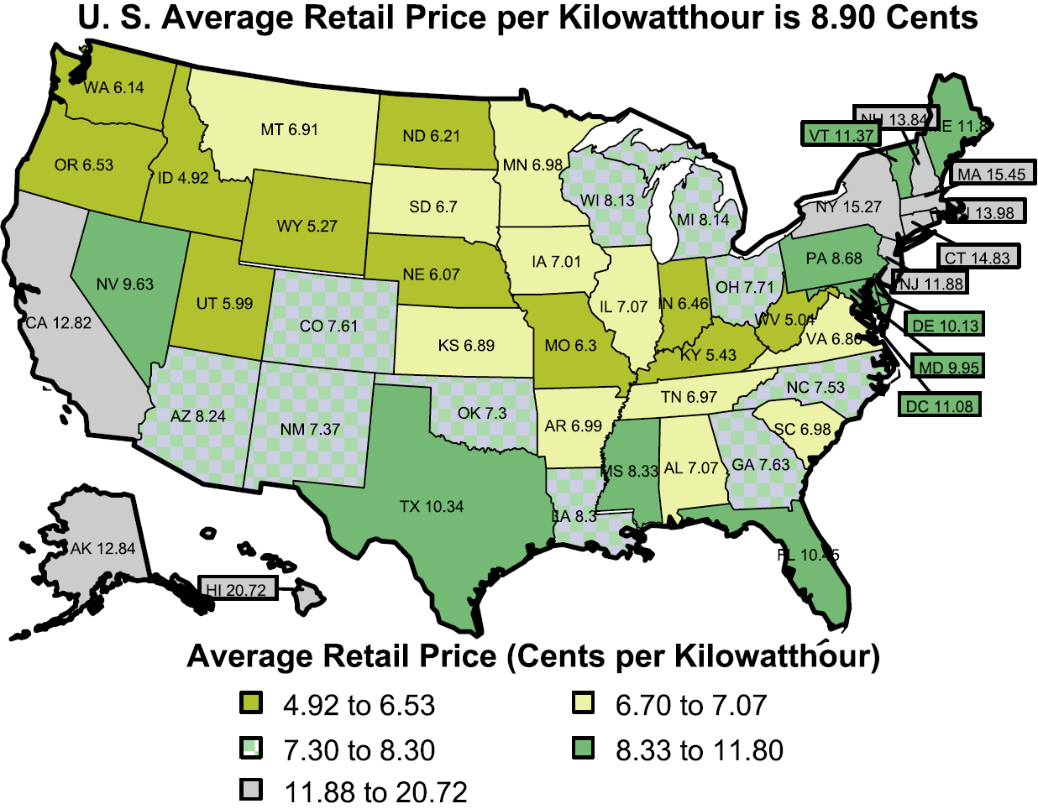
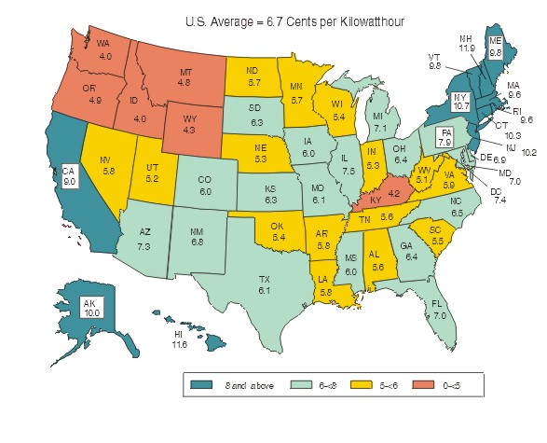
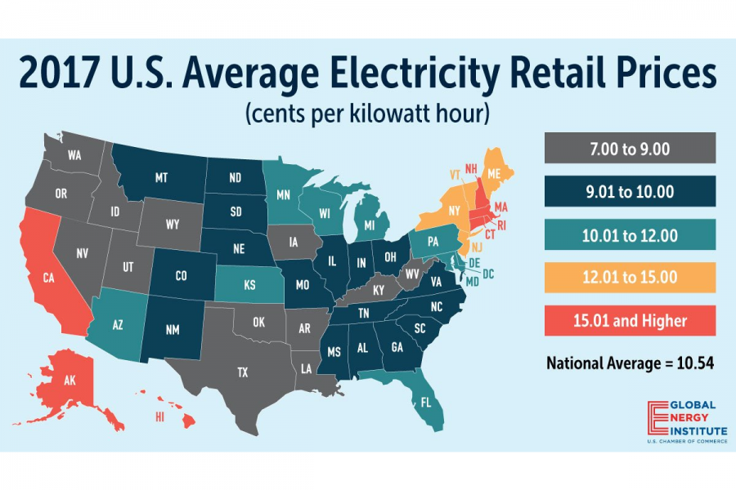
Evolution of Electric Industry
1992 Electric Policy Act
  Exempt Wholesale Generators: class of unregulated generators of any technology, utilities did not have to buy their energy.
  But utilities did have to provide transportation (wheeling) for wholesale transactions; no rules were specified regarding transmission service price.
The 1992 EPA motivated by price disparity throughout the US. Large industrials were hungry for lower prices.
1992
2006

Slide 33
Evolution of Electric Industry
1996 FERC Orders 888, 889, required IOUs to
  file nondiscriminatory transmission tariffs
  pay tariffs for transmission service for their own wholesale transactions
  maintain an information system that gives equal access to transmission information (OASIS)
  functionally unbundle their generation from “wires”
  FERC order did not specify how; can be done via divestiture or “in-house”
Major outages: WSCC (’96,’97), Bay area (‘98), NY (‘99), Chicago (‘00)
1997: Startup of 21 OASIS nodes across US
1998 (April) California legislation gave consumers right to choose supplier
  1999 (June) 1% residential, 3% small commercial, 6% commercial, 21% large industrial, 3% agricultural have switched providers in California
  2000 (Jan) 13.8% of total load switched in Cal
1996-2002: Independent System Operators begin: PJM, ISO-NE, ERCOT, CALISO, NYISO, MISO, SPP. ISOs own no transmission but are responsible for operating and planning the grid, and operating electricity markets. Most ISOs also obtained RTO status (see next slide).

Slide 34
Transmission and
System Operator
G
G
G
Transmission
Operator
G
G
G
G
G
G
Transmission
Operator
G
G
G
Independent
System
Operator
G
G
Transmission
Operator
Vertically Integrated Utility
1900-199?
G
G
Today

Slide 35

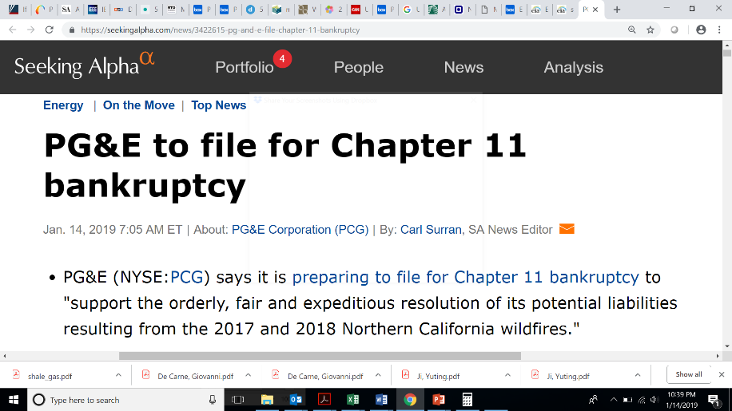
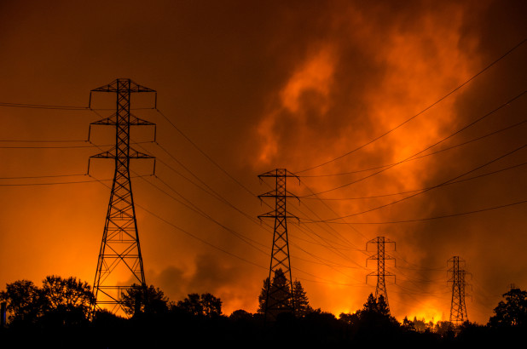
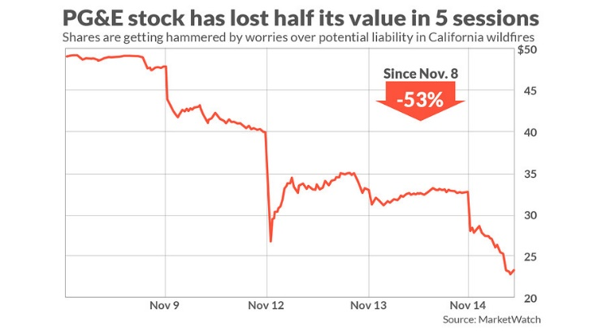
Evolution of Electric Industry
2000 FERC Order 2000 formalized operating, planning, market functions and also required significant regional size to become a regional transmission organizations (RTO). US ISOs subject to FERC jurisdiction (not ERCOT) that satisfy a list of requirements become RTOs.
2000-2001 California energy crisis
  Drought, hot weather, outaged generation, natural gas shortage, transmission bottlenecks, flawed market design allowing price manipulation by some companies, problematic political forces
2001, April PG&E went bankrupt
2001, November Enron collapse(www.investopedia.com/updates/enron-scandal-summary/)
2002 FERC standard market design issued.
2003 Major blackout in the northeast US

Slide 36
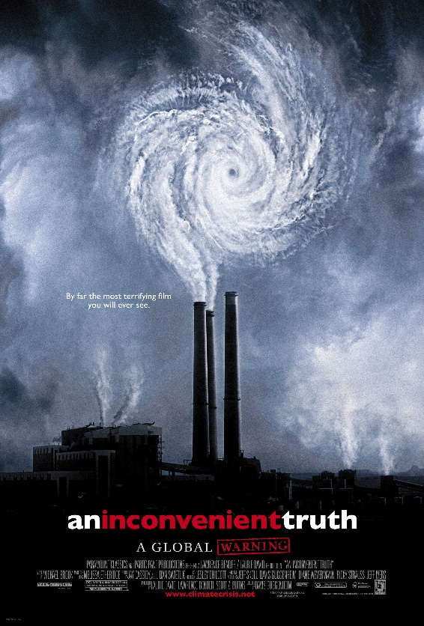
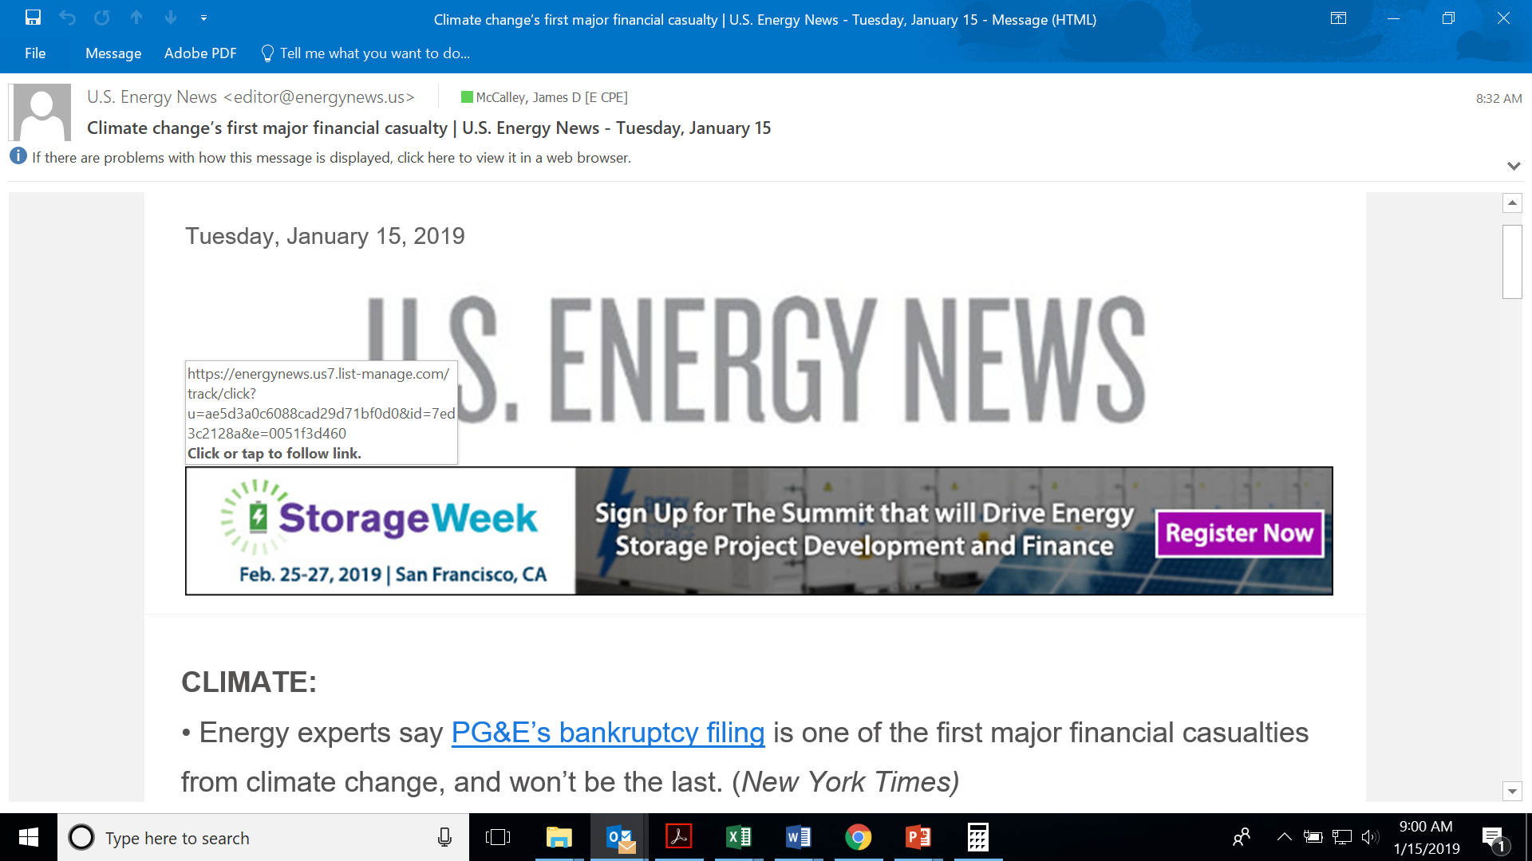
Evolution of Electric Industry
2004, First large wind farm in Iowa (160.5MW Intrepid plant in NW Iowa)
2005, National Energy Policy Act: Quotas on ethanol, $$ for clean coal R&D, large incentives to build nukes, repeals PUCHA (SEC authority to FERC).
2006, “An inconvenient truth” (Al Gore) about global warming
“The effects of global warming on temperature, precipitation levels, and soil moisture are turning many of our forests into kindling during wildfire season.”
7//24/18, Union of Concerned Scientists, www.ucsusa.org/global-warming/science-and-impacts/impacts/global-warming-and-wildfire.html#.XD4ZYlxKg2w

Slide 37
Evolution of Electric Industry
2008, Economic depression, Obama elected
2009, In response to depression Obama initiated the American Recovery and Reinvestment Act of 2009, which included $80B “energy money” as follows:
  $3.4B for smart grid investment
  Launched the Advanced Research Projects Agency (ARPA-E) to fund innovative energy concepts
  Imposed new efficiency standards for home appliances
  Imposed fuel efficiency policies for cars
  Increase production of biofuels
  Required reporting of greenhouse emissions by power plants
2010, Obama proposed an energy security plan to reduce offshore energy need
2011, Obama state of union: 80% of US electricity from clean sources by 2035
2015, Obama’s EPA: Clean Power Plan to lower power plant CO₂ emissions
2016, 2/3 electric utilities support CPP, but congressional & legal pushback abounds
2016, Trump elected
2017, US withdraws from Paris Agreement
2018, Trump proposes Affordable Clean Energy Rule, giving CO₂ authority to states

