Slide 1
Final Exam Summary
EE 457, April 30, 2015
Dr. McCalley

Slide 2
Final Exam Format
Our final scheduled for Monday 9:45-11:45, this room.
Open book, open notes (but paper only, i.e., cannot bring notes electronically)
Calculator permitted.
No communication devices (includes computers).
120 minutes.
Type of questions:
Problems
Short answer and/or true false.
Most of you will stay in the room for the entire 120 minutes.

Slide 3
Final Exam Special Instructions
On-campus students in the in-class section must take the exam at 9:45-11:45 Monday 5/4.
On-campus students in the on-line section must complete exam between 9am and 2pm on Monday 5/4.
Off-campus students in the on-line section must complete exam between 8 am Monday 5/4 and 11:59 pm Tuesday 5/5.
All on-line students may choose to take the exam during the in-class section at 9:45 Monday.

Slide 4
Final Exam Summary of Topics
Symmetrical faults
Unsymmetrical faults
System protection
Transient stability
Automatic generation control
Economic dispatch and markets
Chapter 13, Protection
Chapter 14, Stability
Chapter 11, AGC
Chapter 11, EDC
Notes on state-estimation
Notes on security assessment
EXAM I
EXAM II

Slide 5
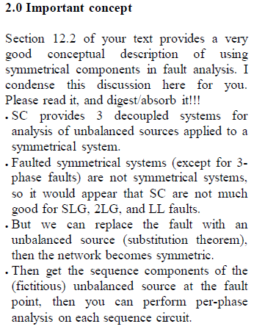
Study suggestions
Know how to work all HW problems.
Read notes and text simultaneously. As you read and review, ask yourself:
What are most central concepts here?
Do I understand what I am doing when I make these calculations?
Bring hard copies of notes to the exam. Bring your book to the exam. Bring your HWs, Exams, to the final exam.

